Slide 1
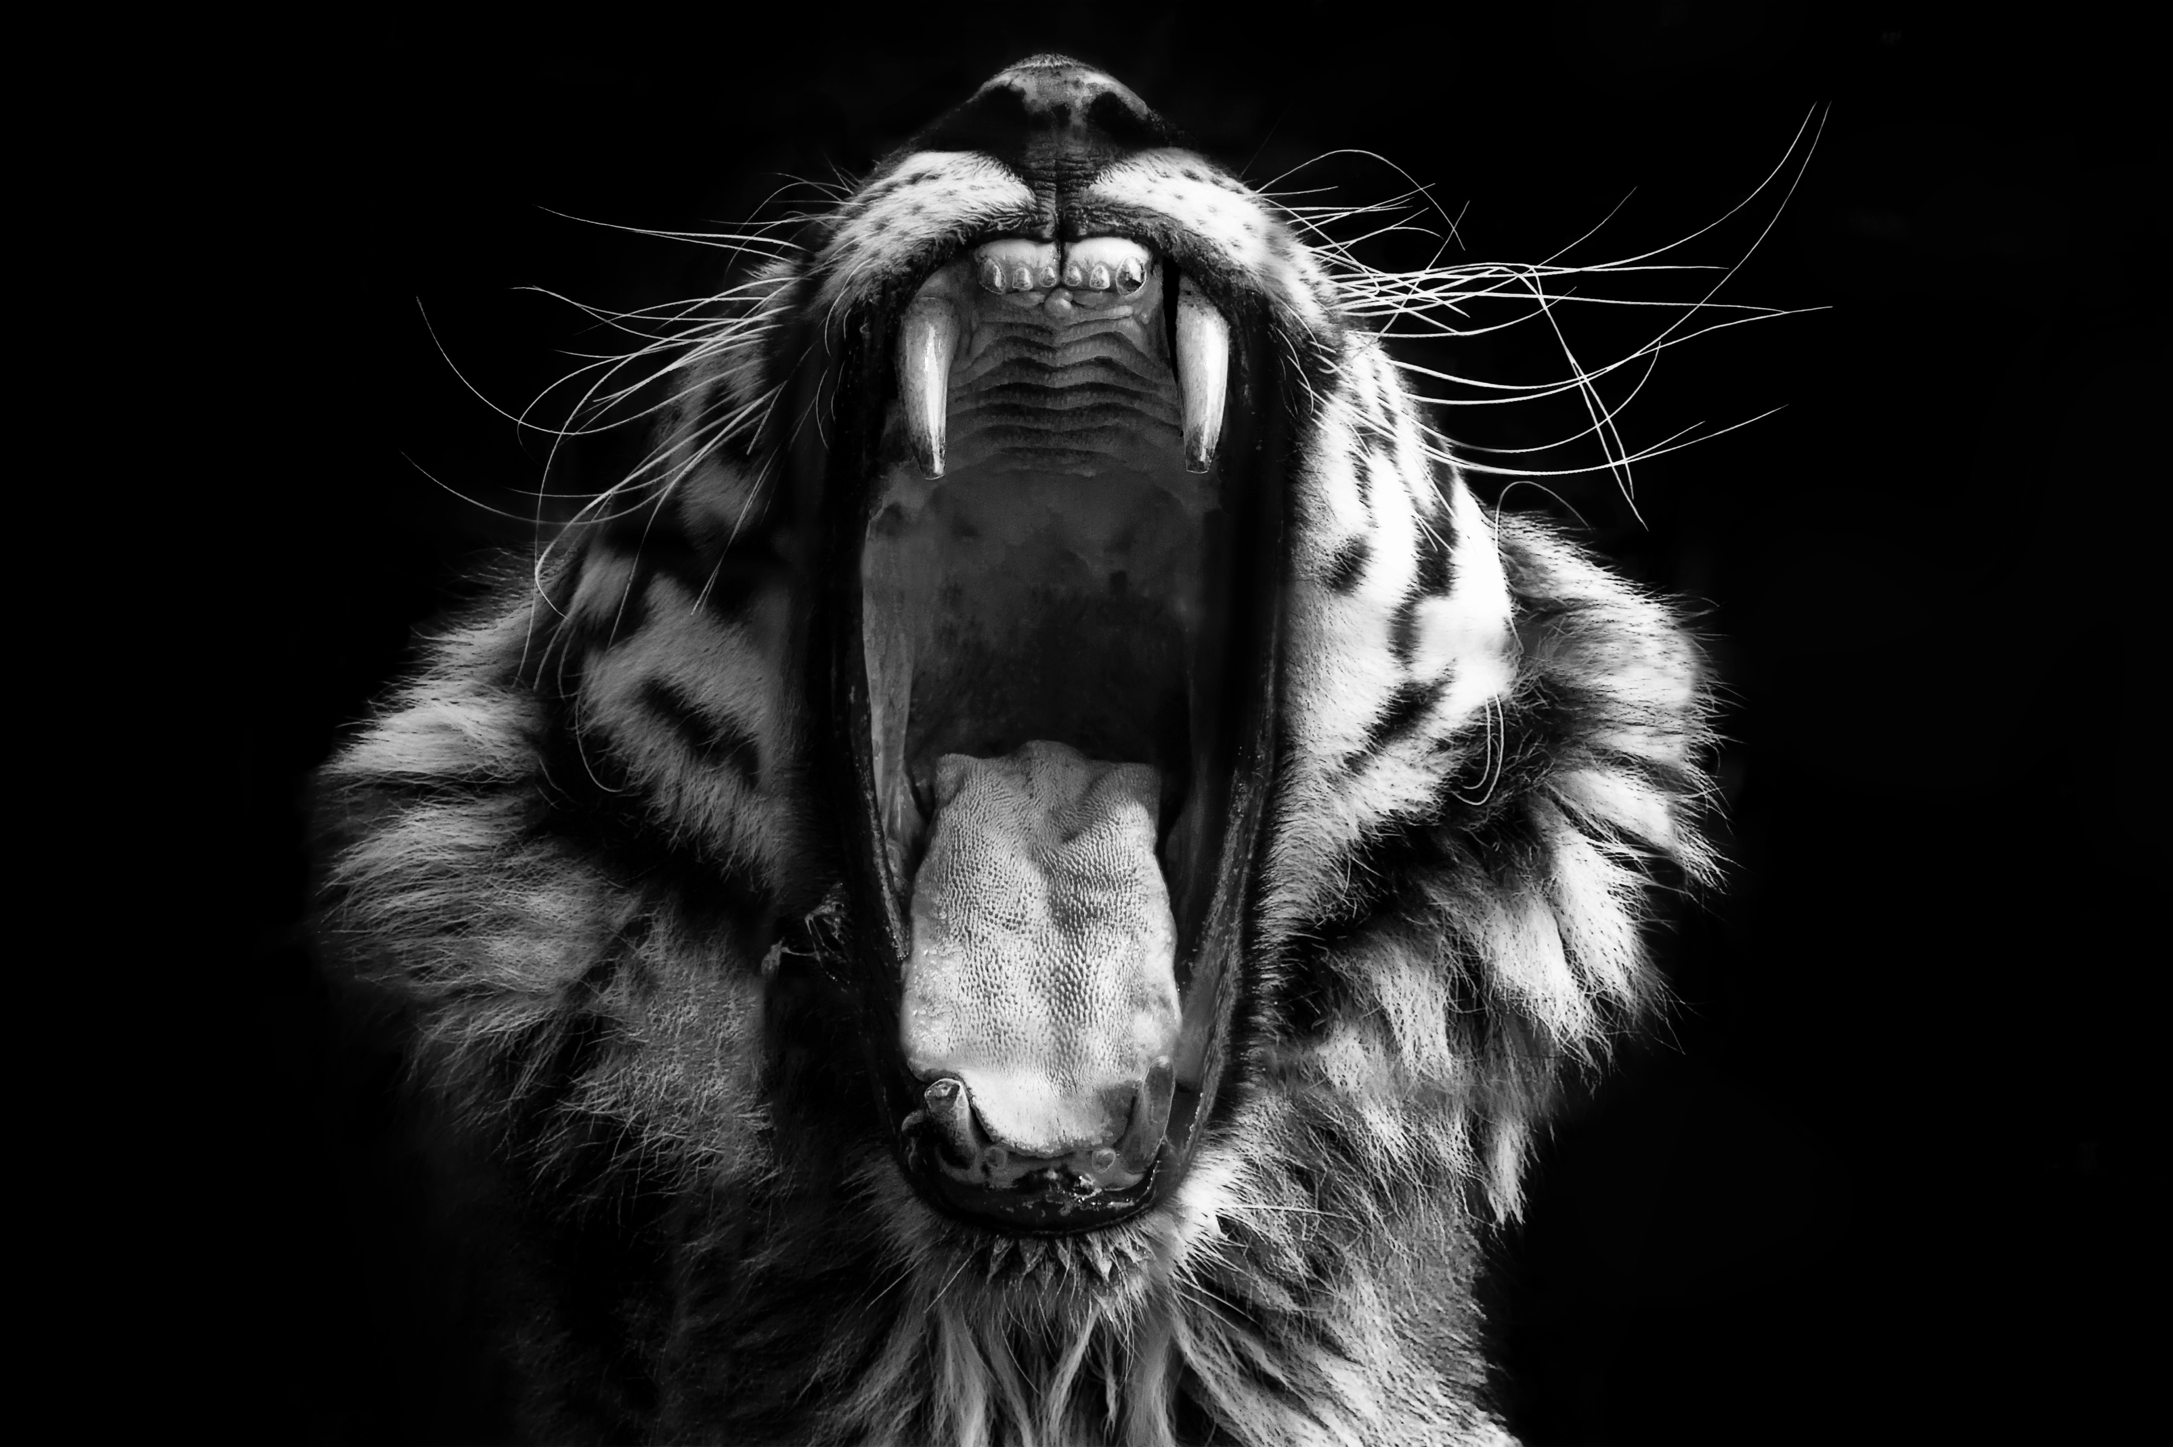
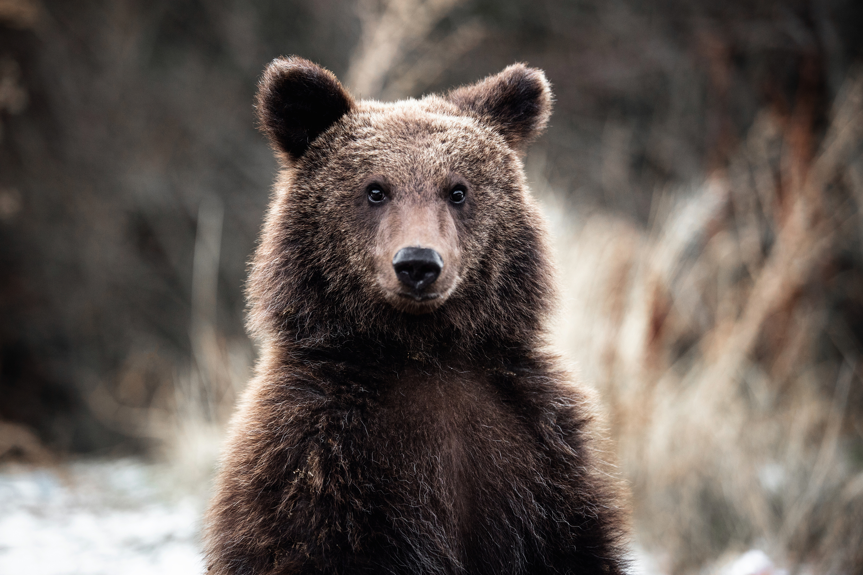
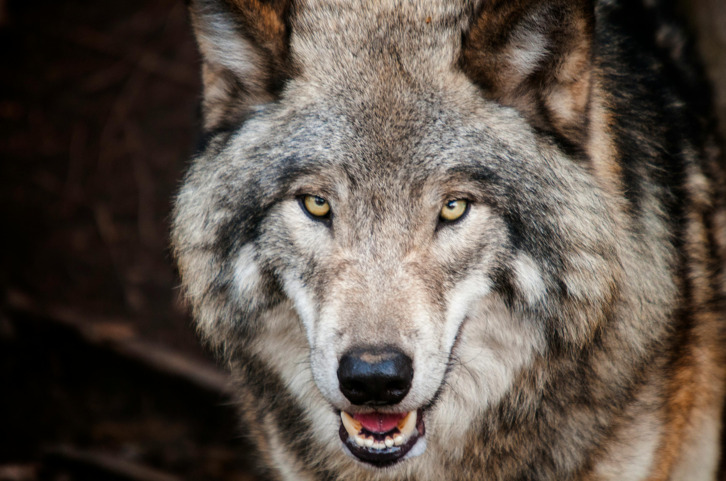
The Maths in the Wild Introduction
Dr John Butler TU Dublin (Lecturer in Mathematics and Statistics)

Slide 2
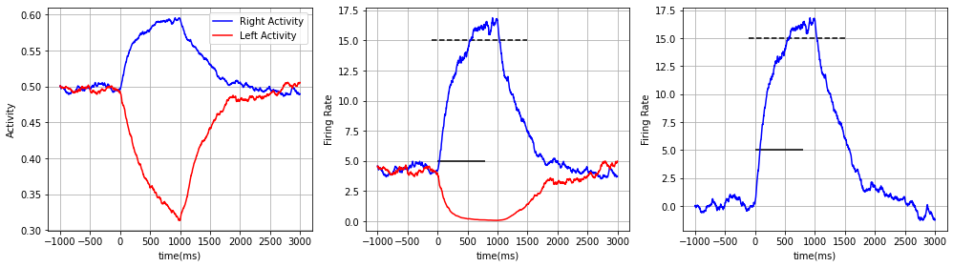
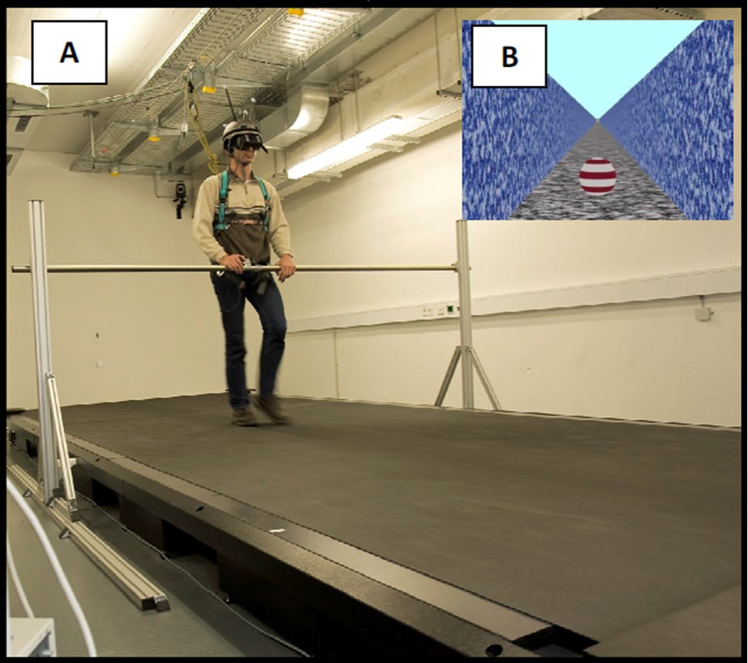
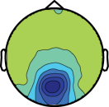
John Butler
Lecturer in School of Mathematics and Statistics (TU Dublin, 2016-)
Adjunct Assistant Professor in Physiology (TCD, 2016-)
How Did I Get Here:
PhD in Computational Fluid Dynamics (TCD, 2001-2006)
Research on how we interact with our environment (Germany, 2006-2009)
Research on sensory processing in people with Autism (USA, 2009-2013)
Research on movement disorders (TCD, 2013-2015)
Published over 70 research papers in international journals, 14 PhD Students, 11 MSc Student, 17 Undergraduate Students

Slide 3




What Do I Do?
TEACH
RESEARCH
CODE
WRITE

Slide 4

What do I Teach
Mathematics
Computing
Statistics
Electrical Engineering
Neuroscience
Physiology
Psychology
Notes:
I wouldn’t even count it wrong if they answered dancing :D

Slide 5
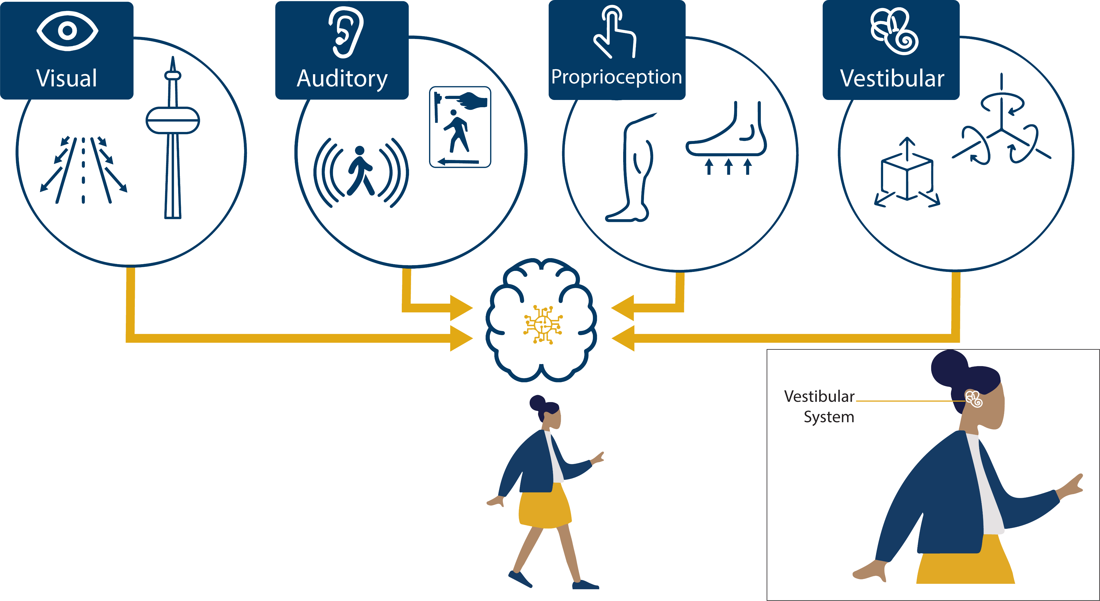
My Research
Campos J, Pandi M and Butler J (2020) “Feeling” Ourselves Move: A Team Effort by Our Senses. Front. Young Minds. 8:9. doi: 10.3389/frym.2020.00009

Slide 6
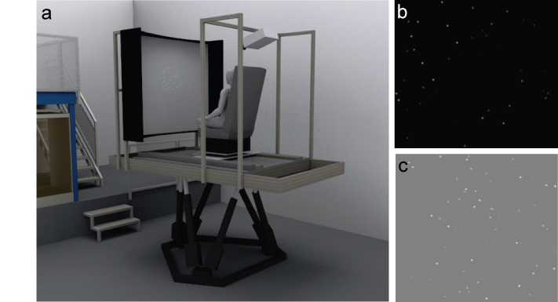
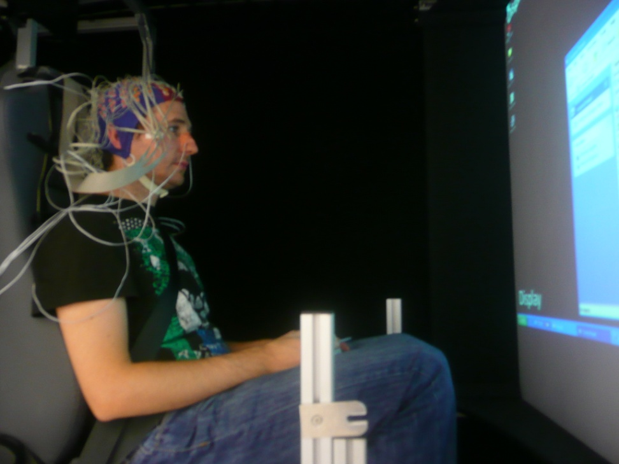
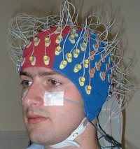
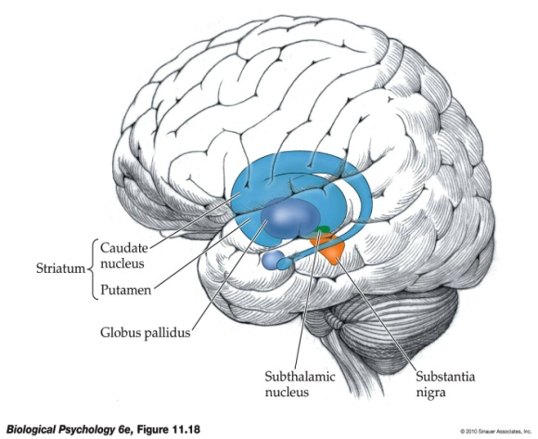

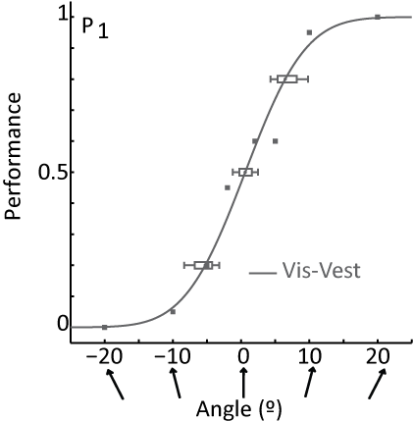
Who Do I Research With
My Research
Computer Science
Neuroscience
Physics
Mathematics
Psychology
Electrical Engineering
Medicine

Slide 7
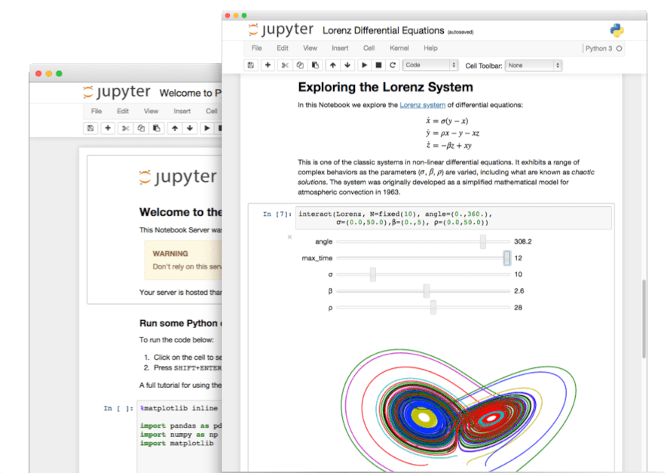
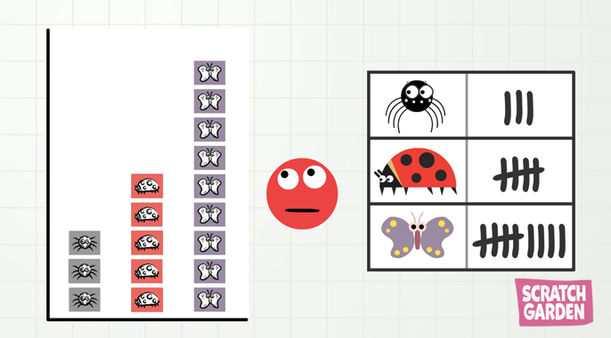
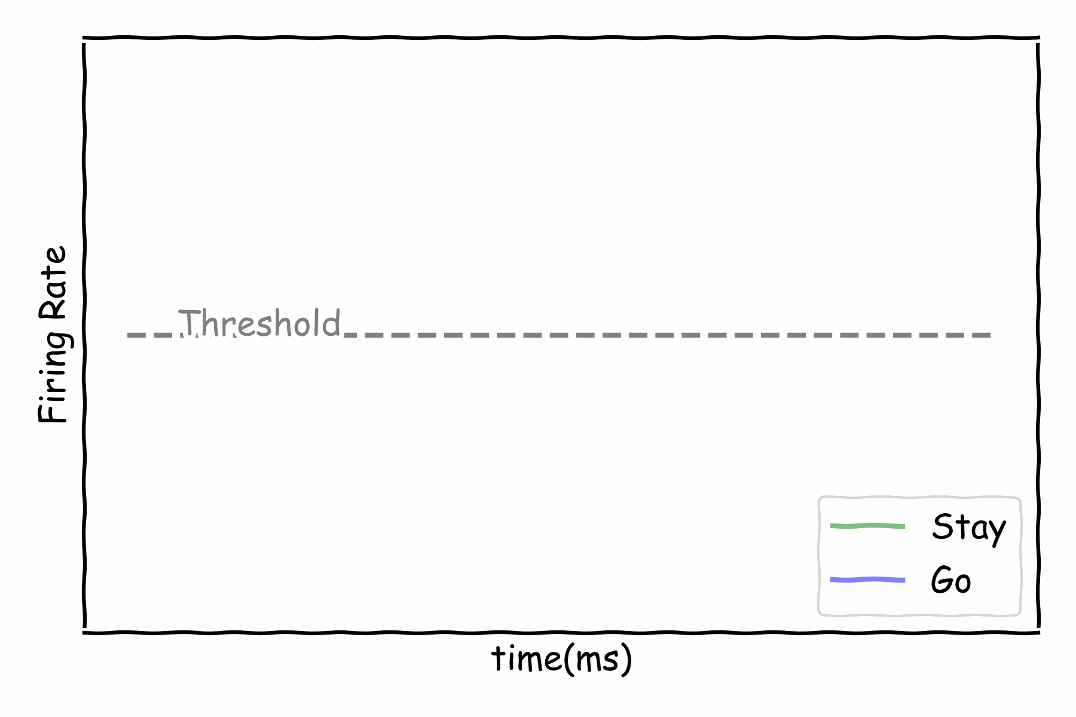
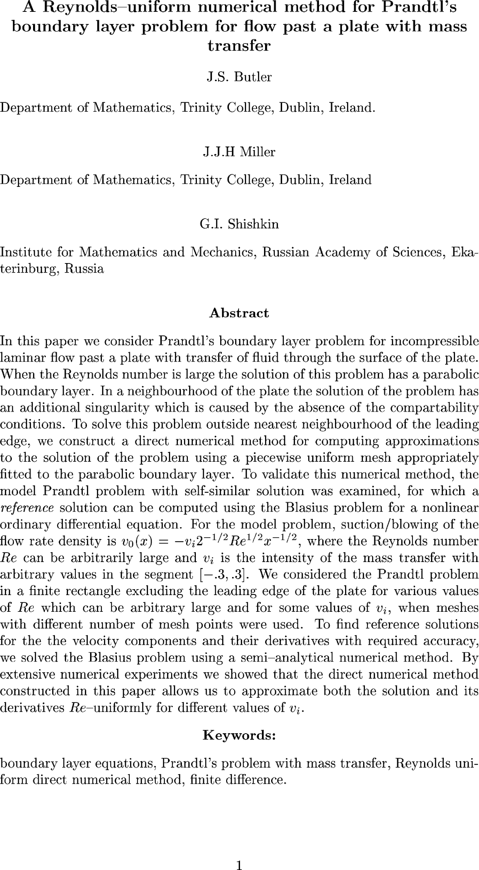
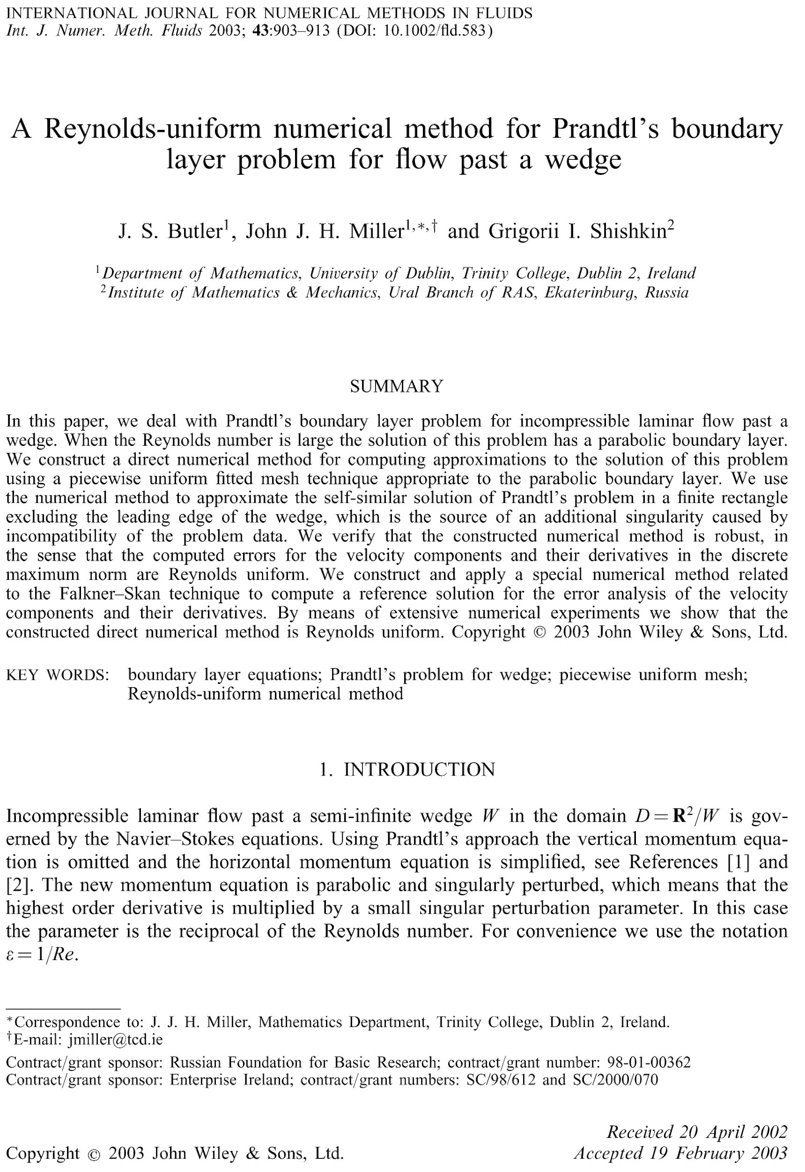
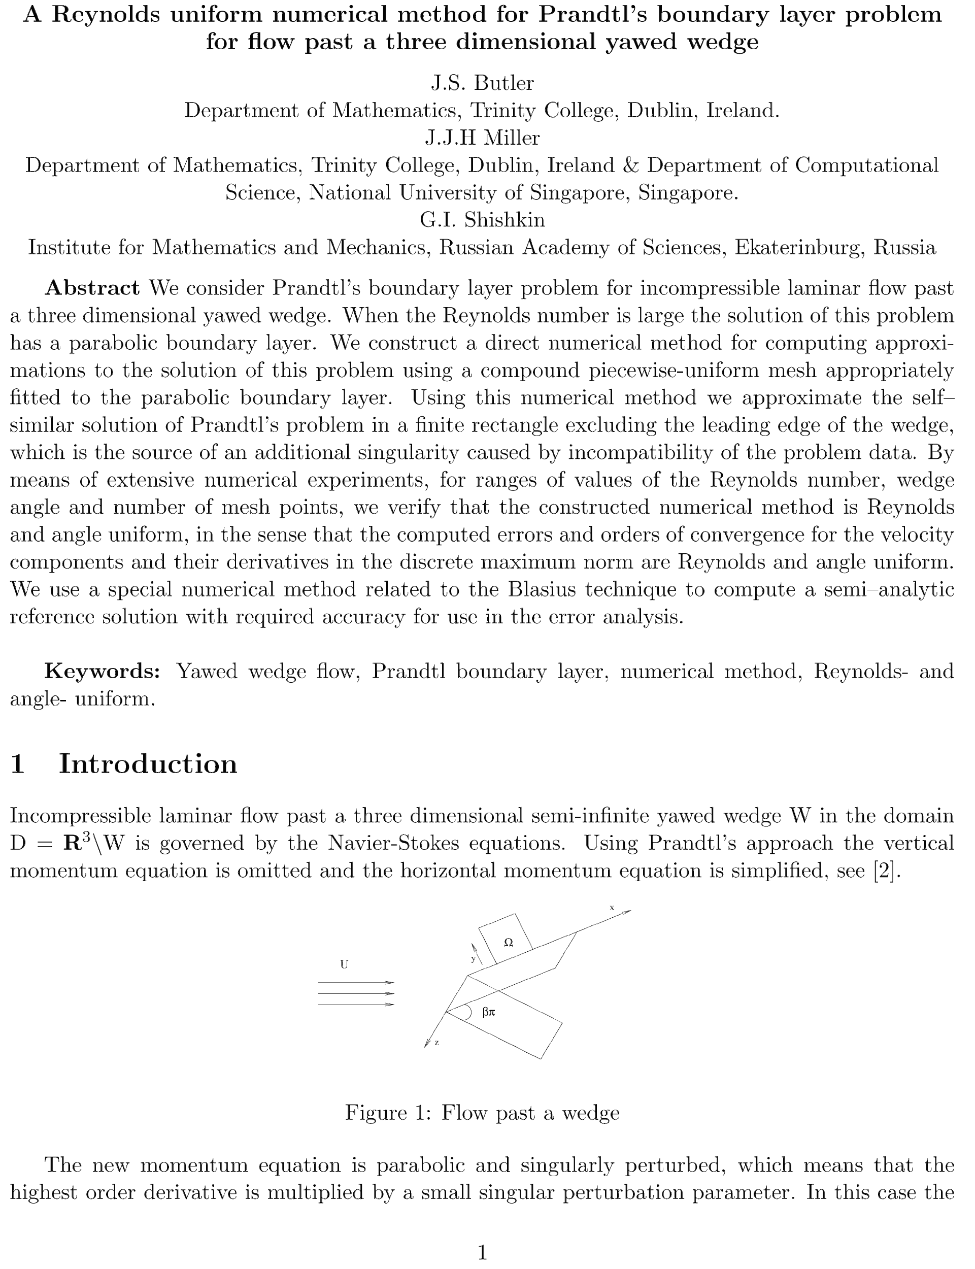
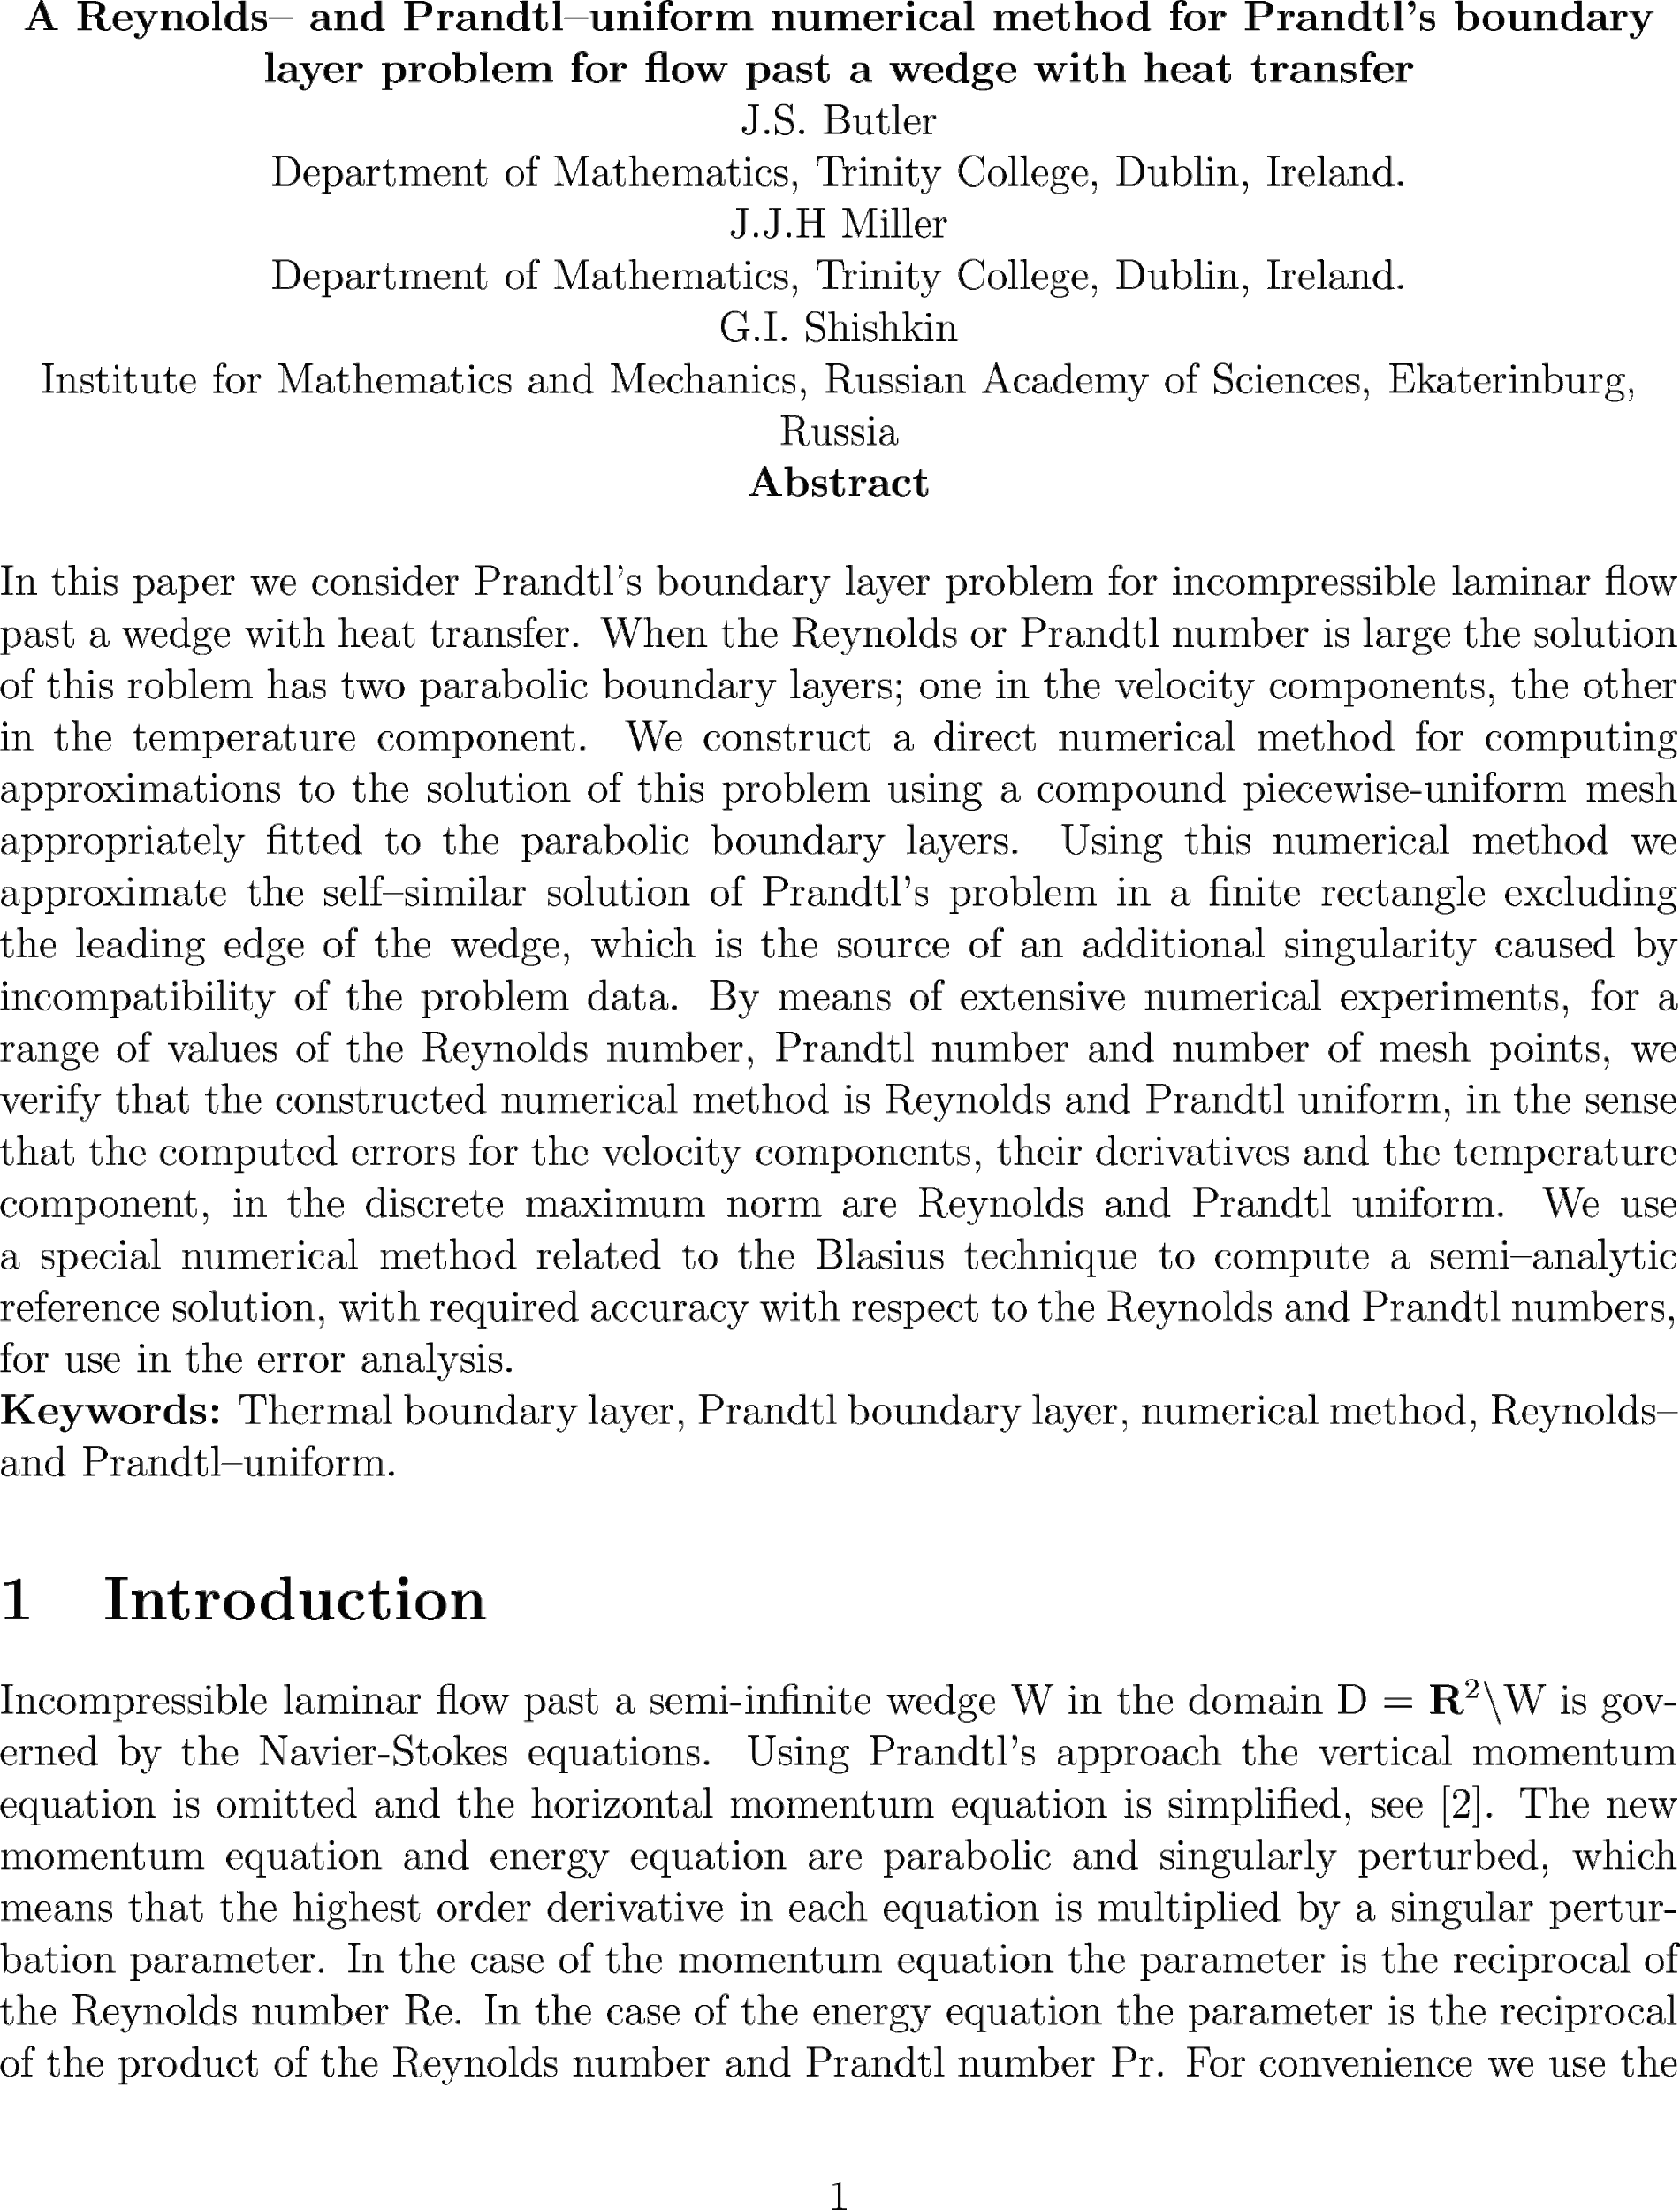
What do I code
To Analyse Data
To Make Mathematical Models
Notes:
More kids friendly photo for data analysis https://scratchgarden.com/wp-content/uploads/2021/11/MMM-Data-03.png

Slide 8
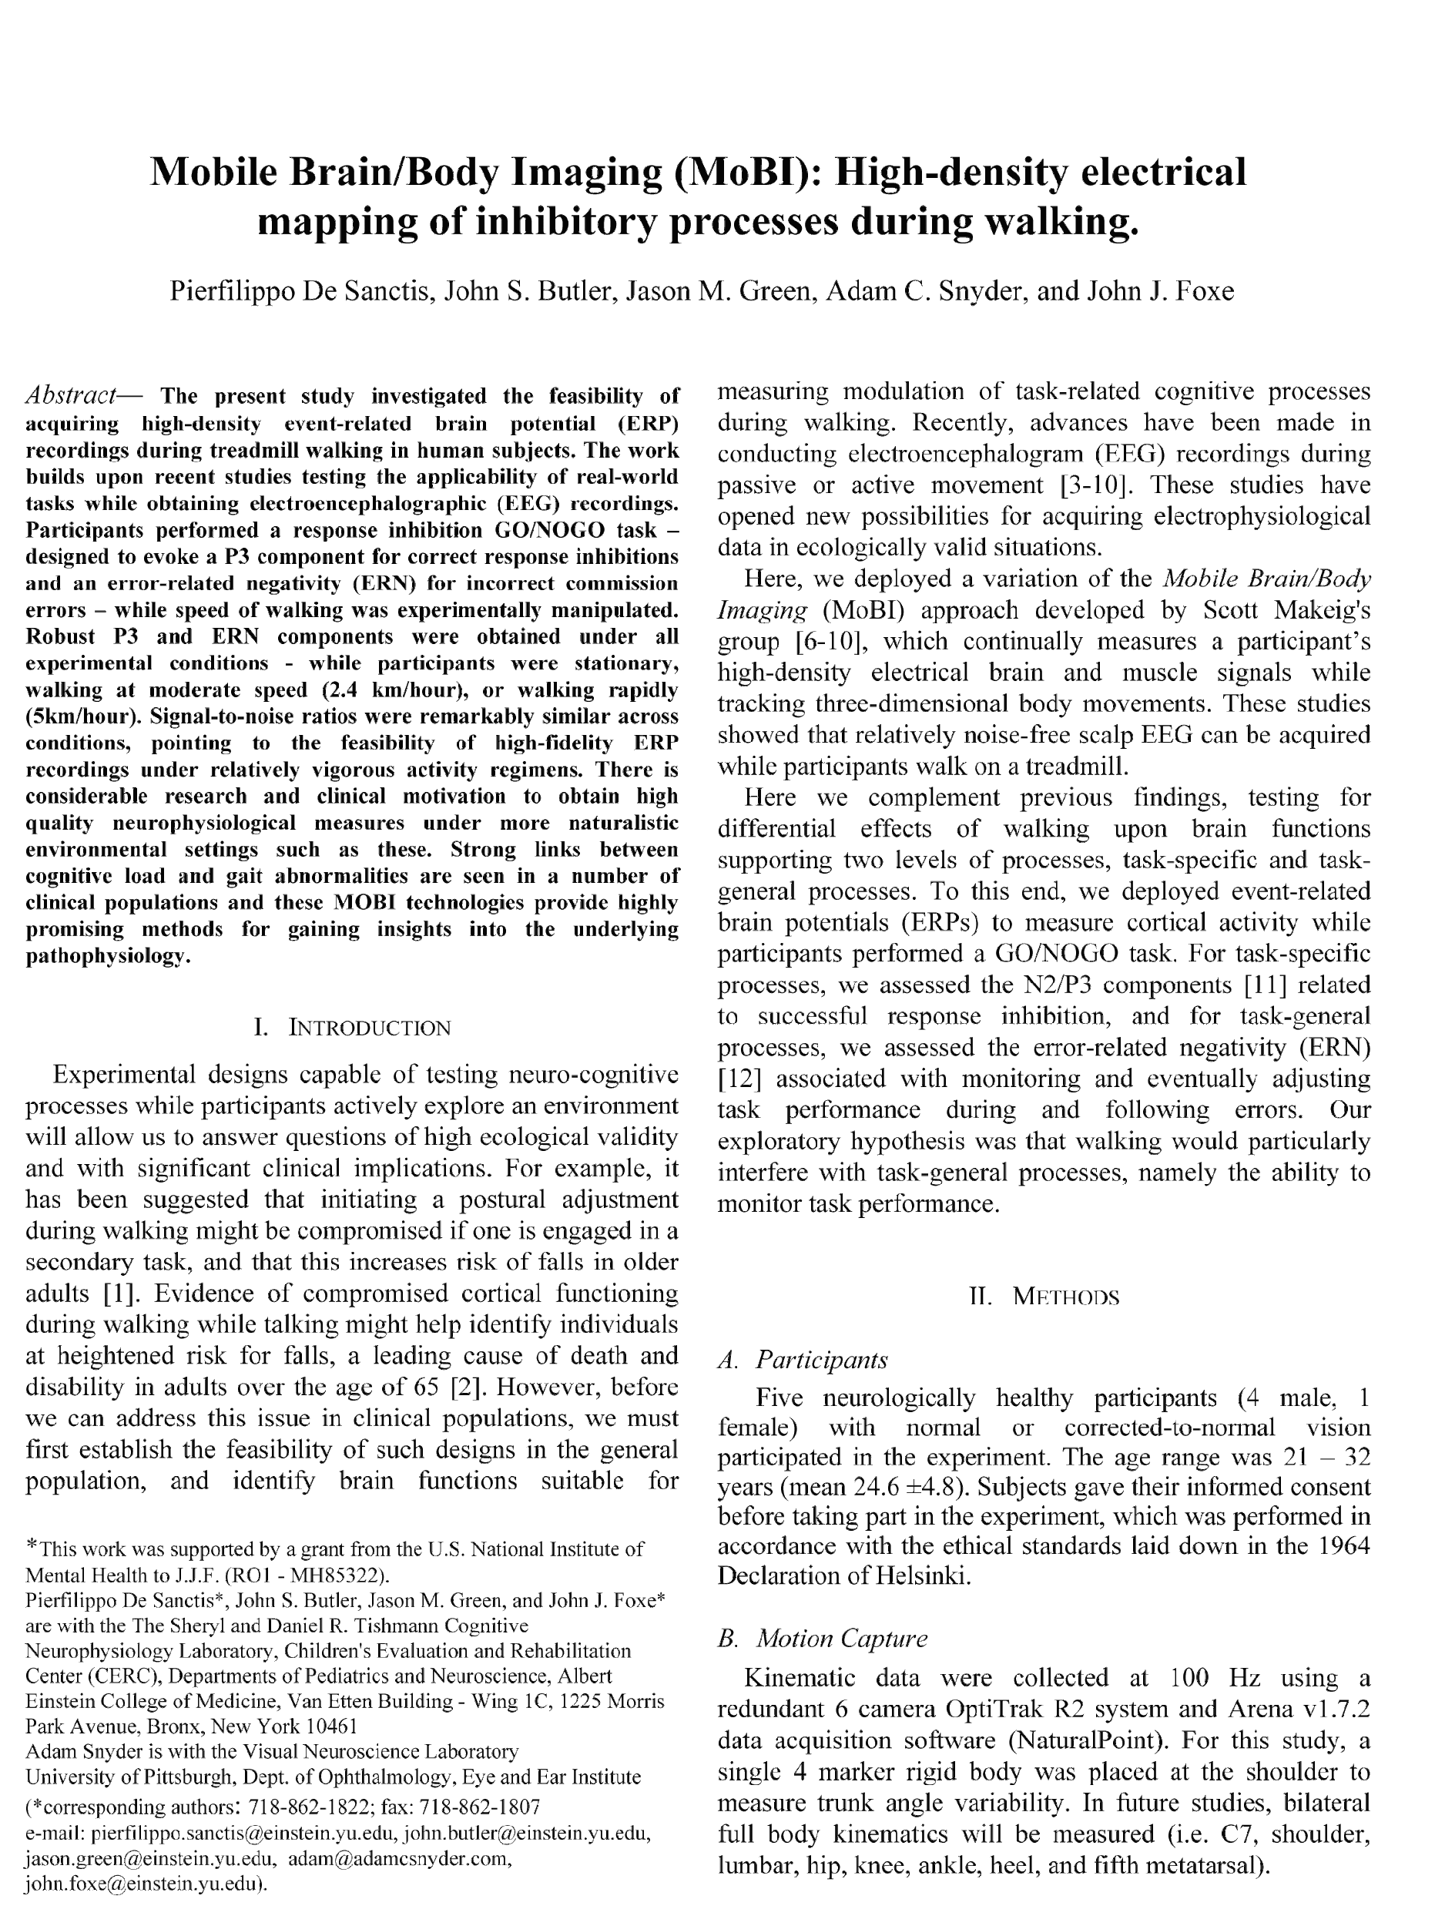
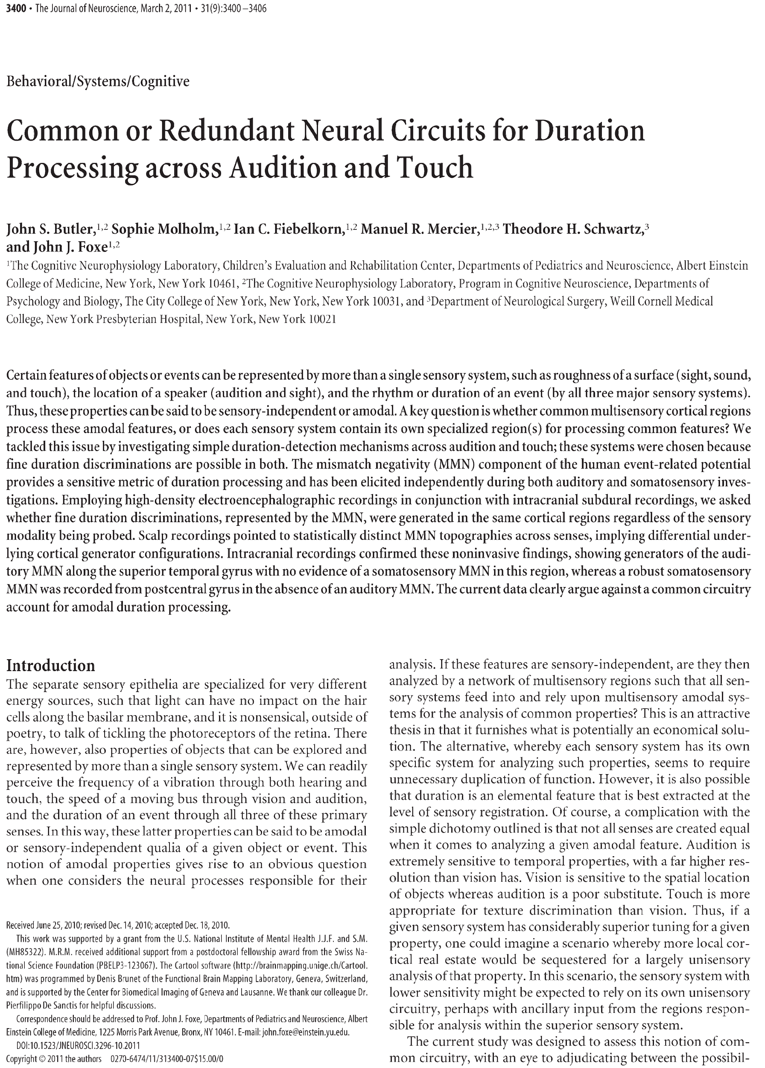
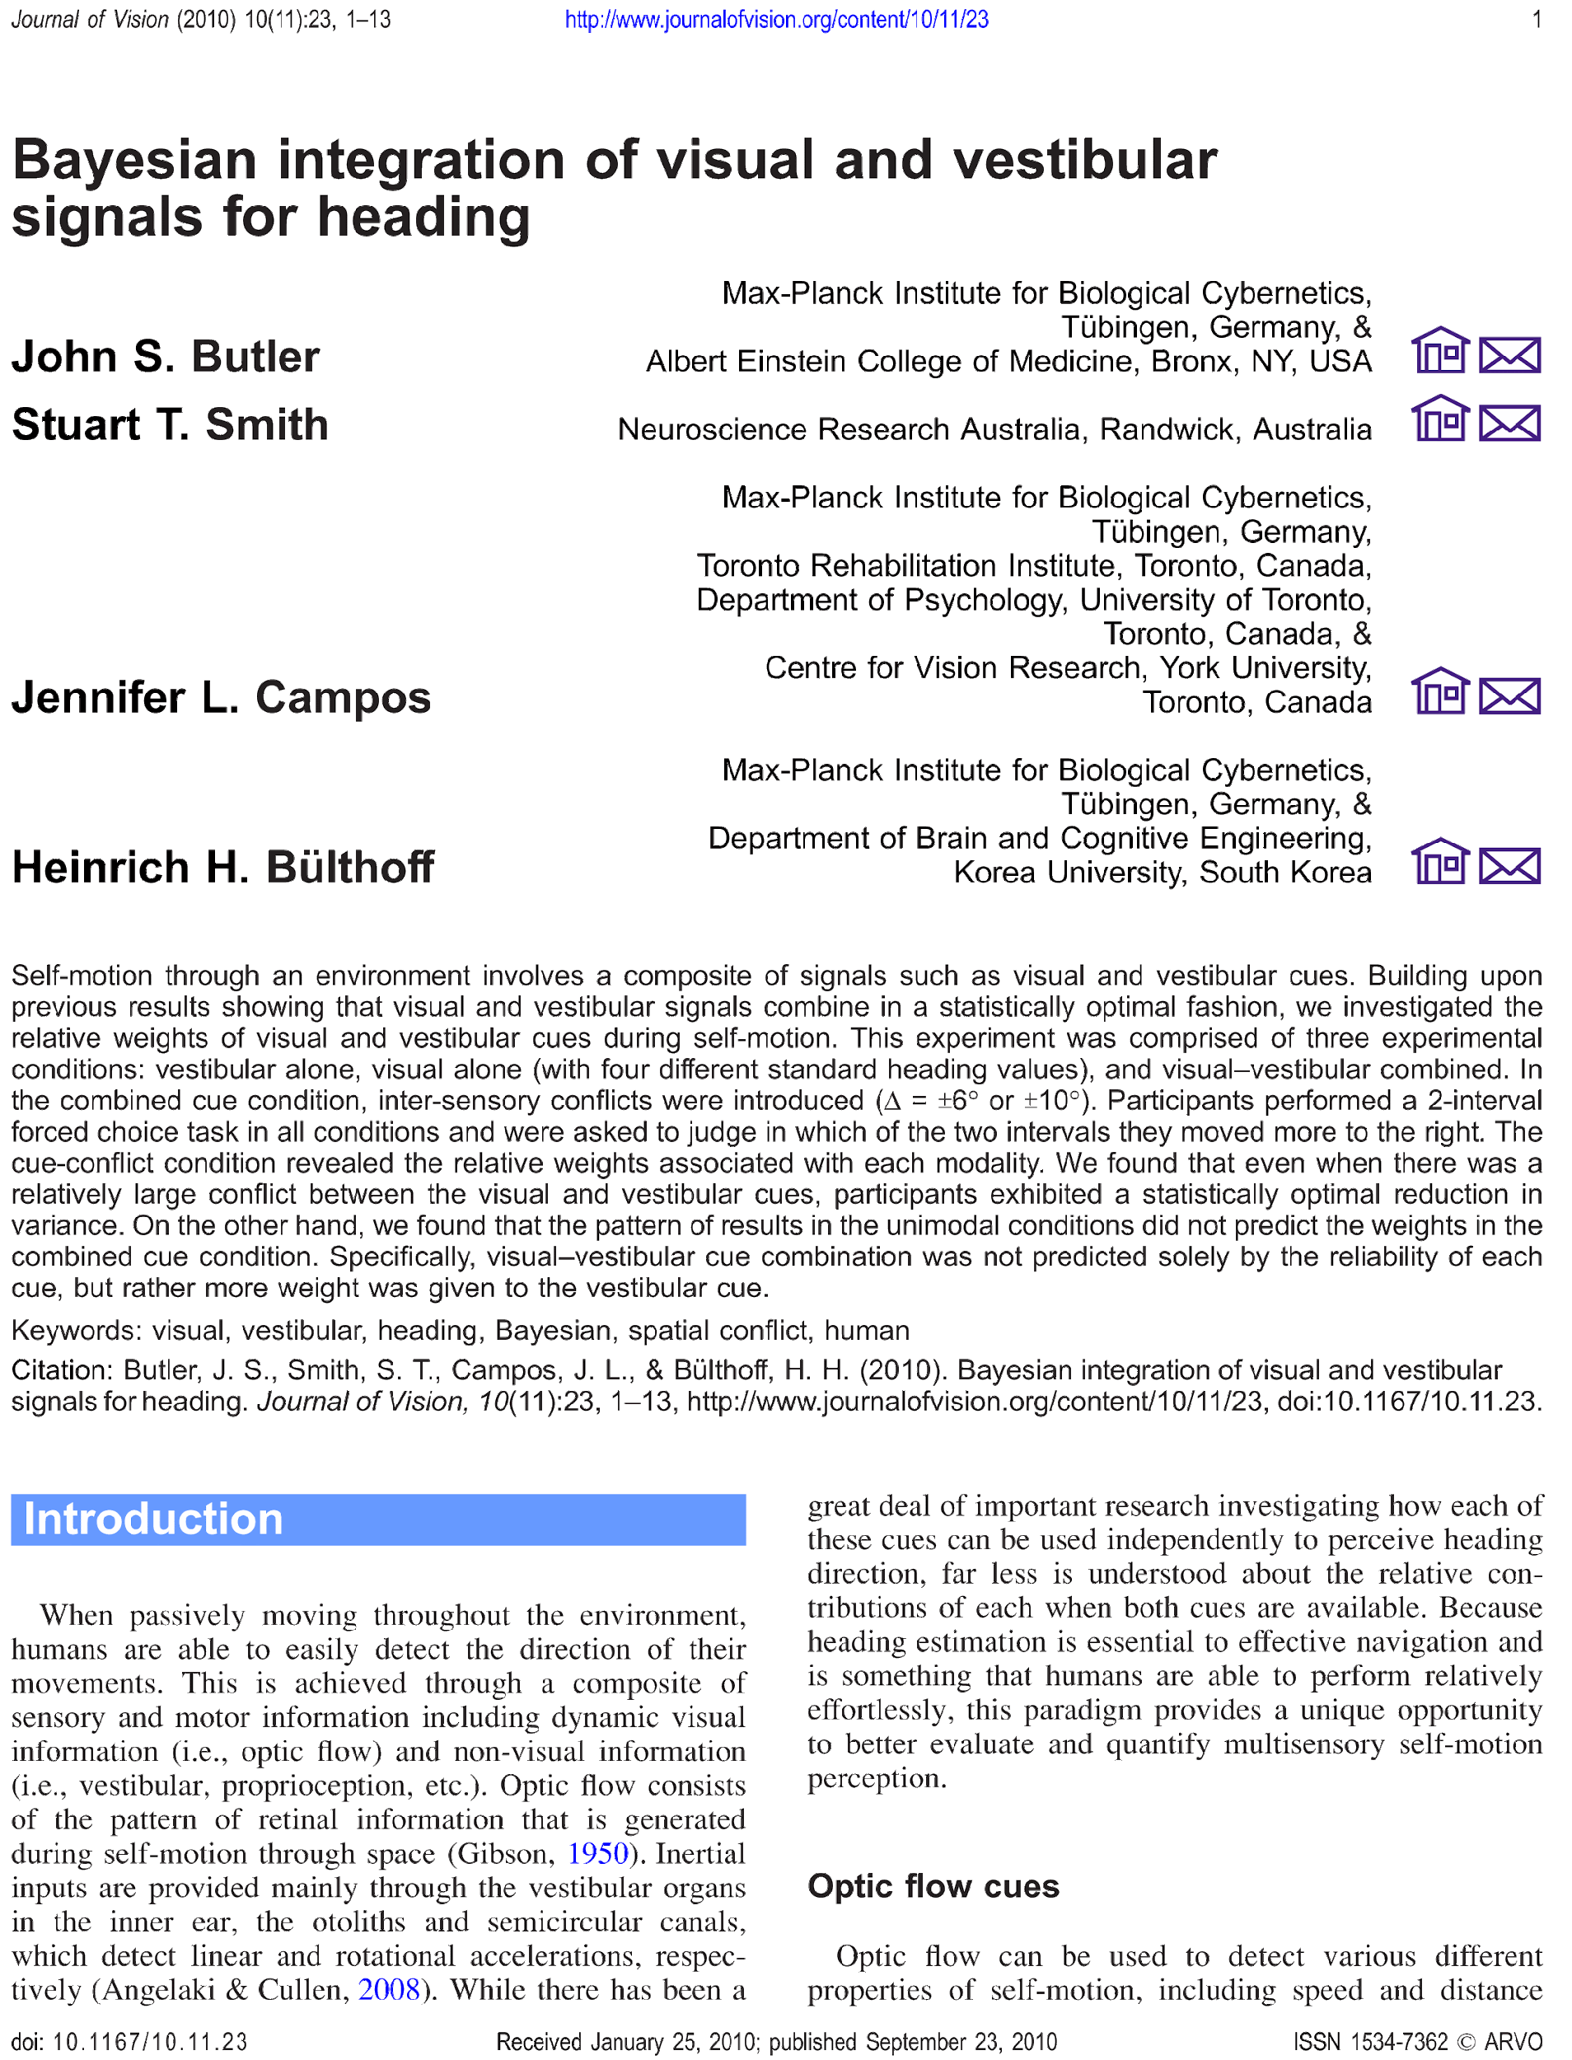
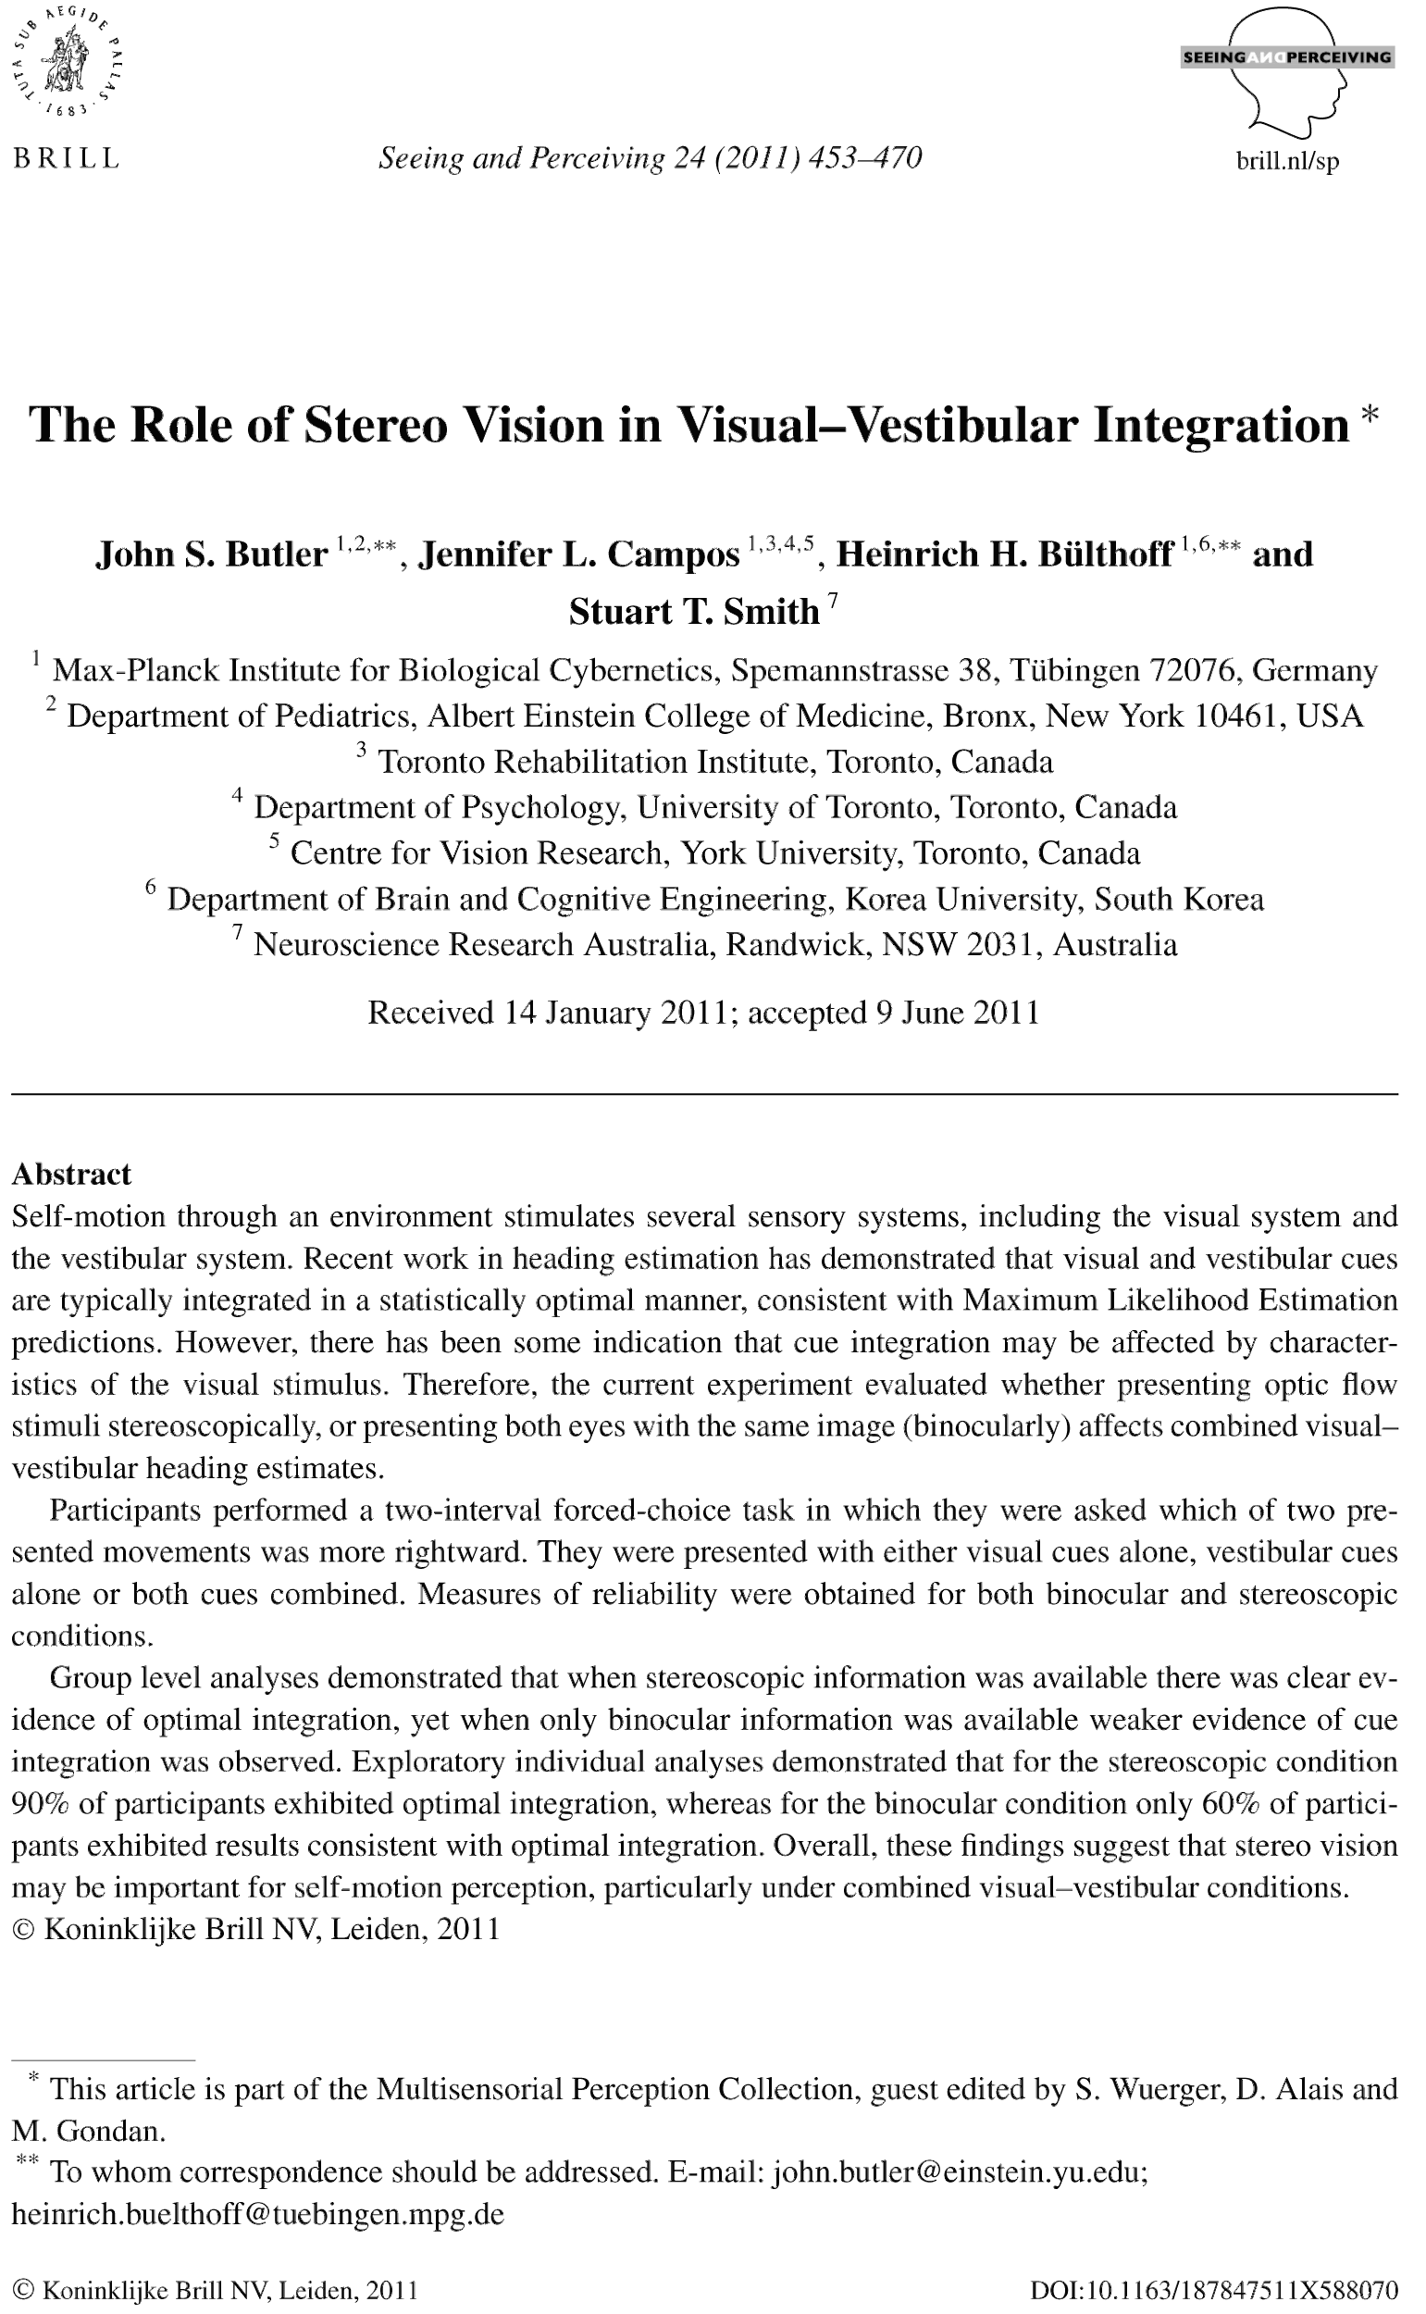
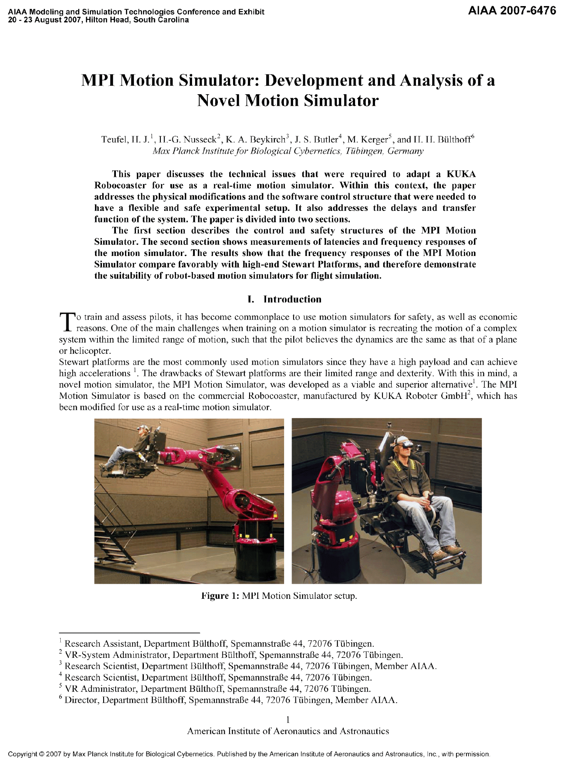
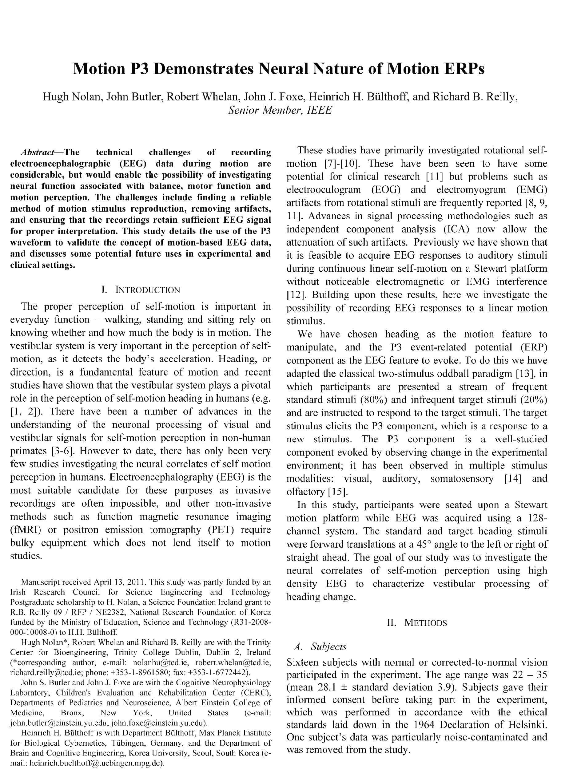
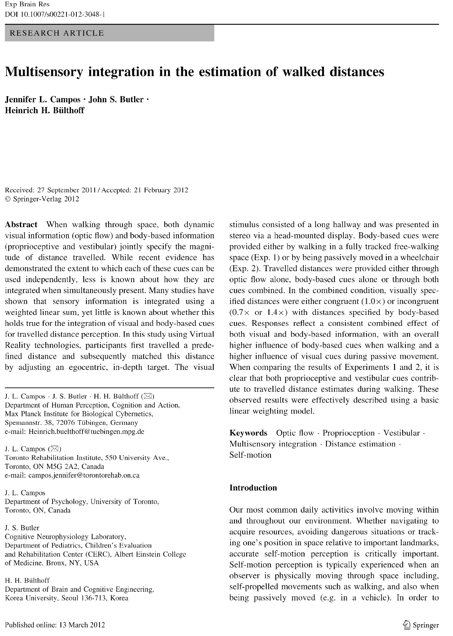
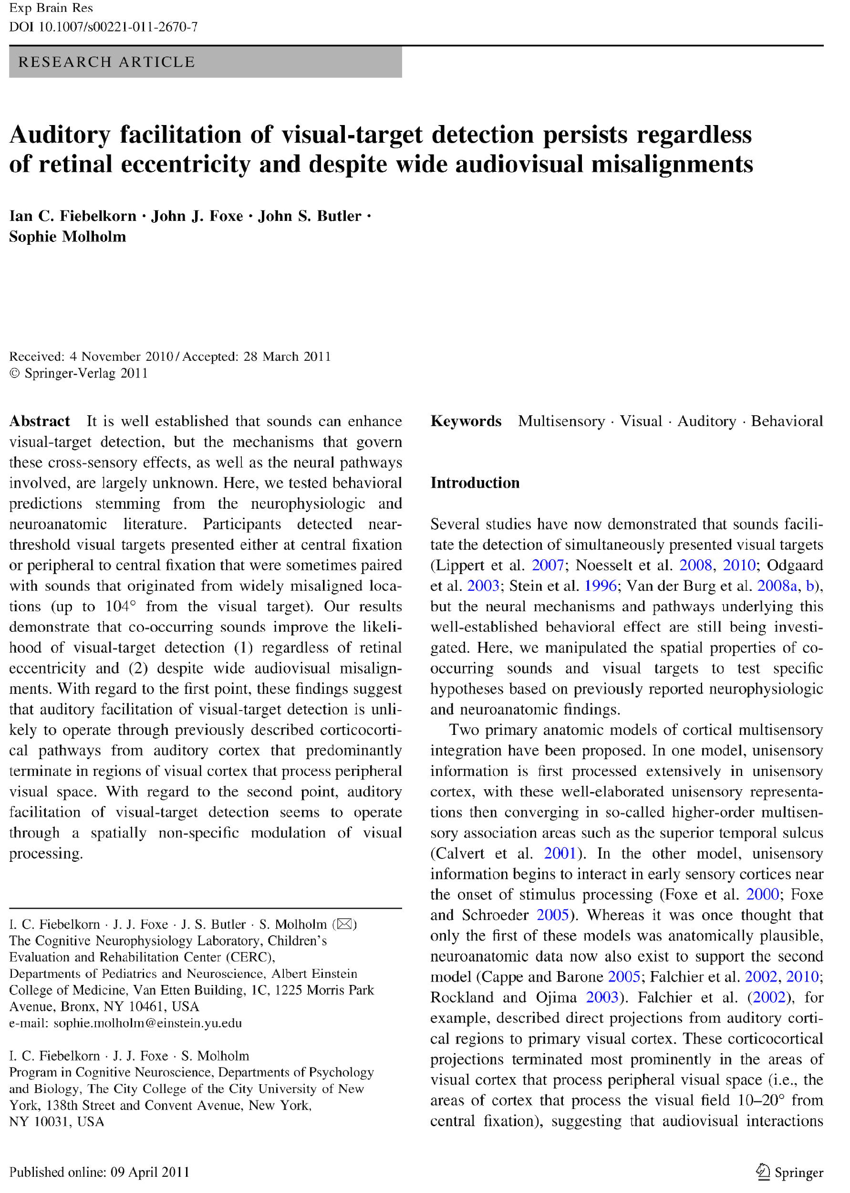
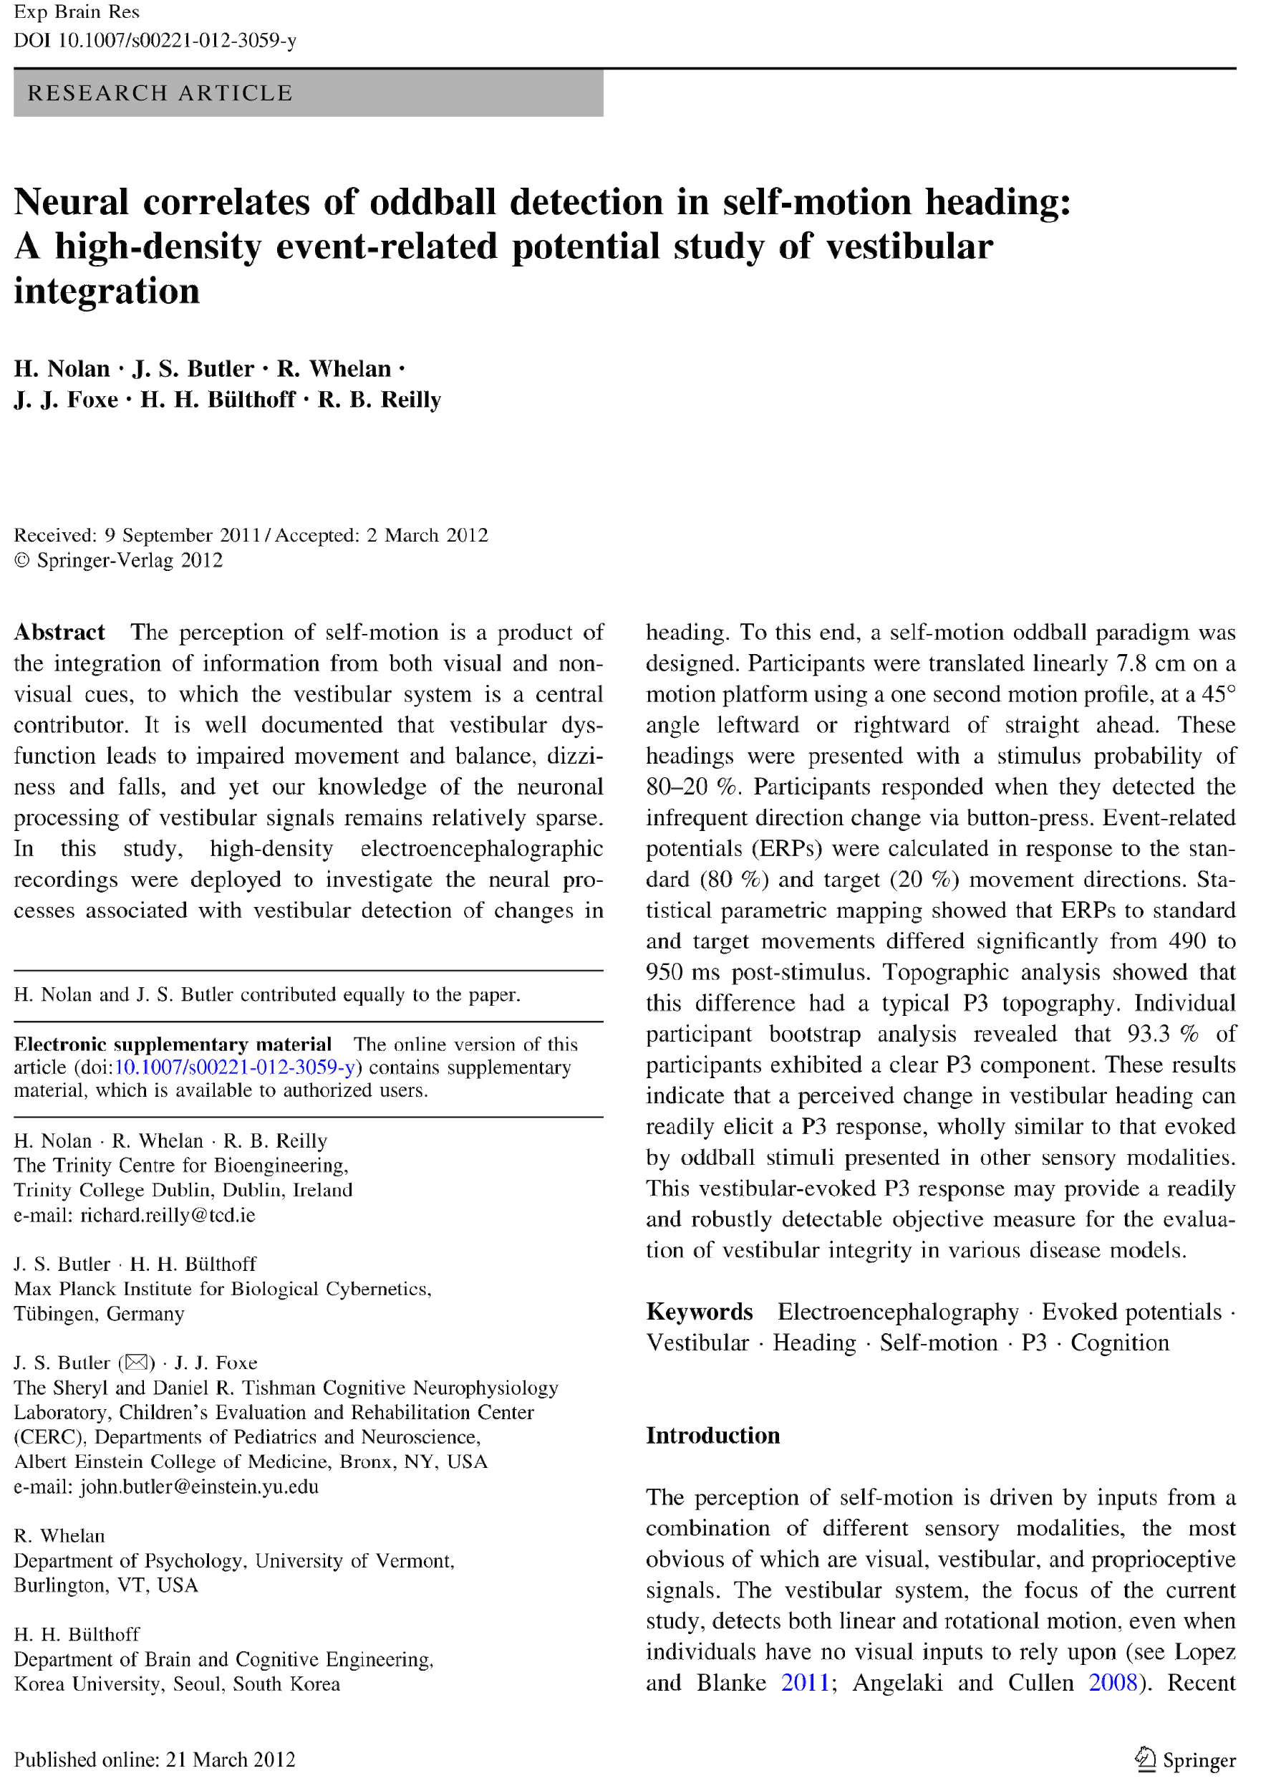
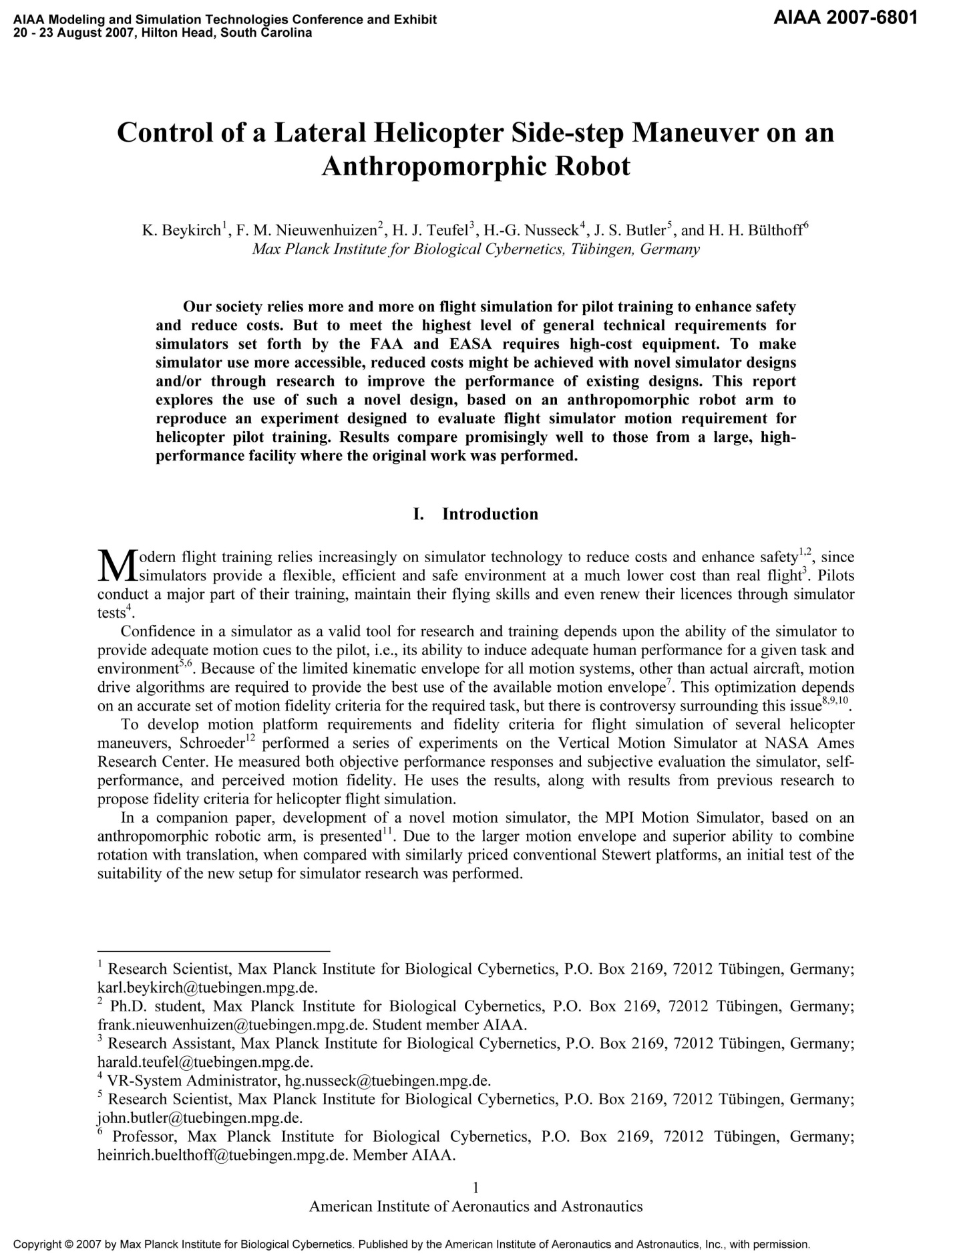
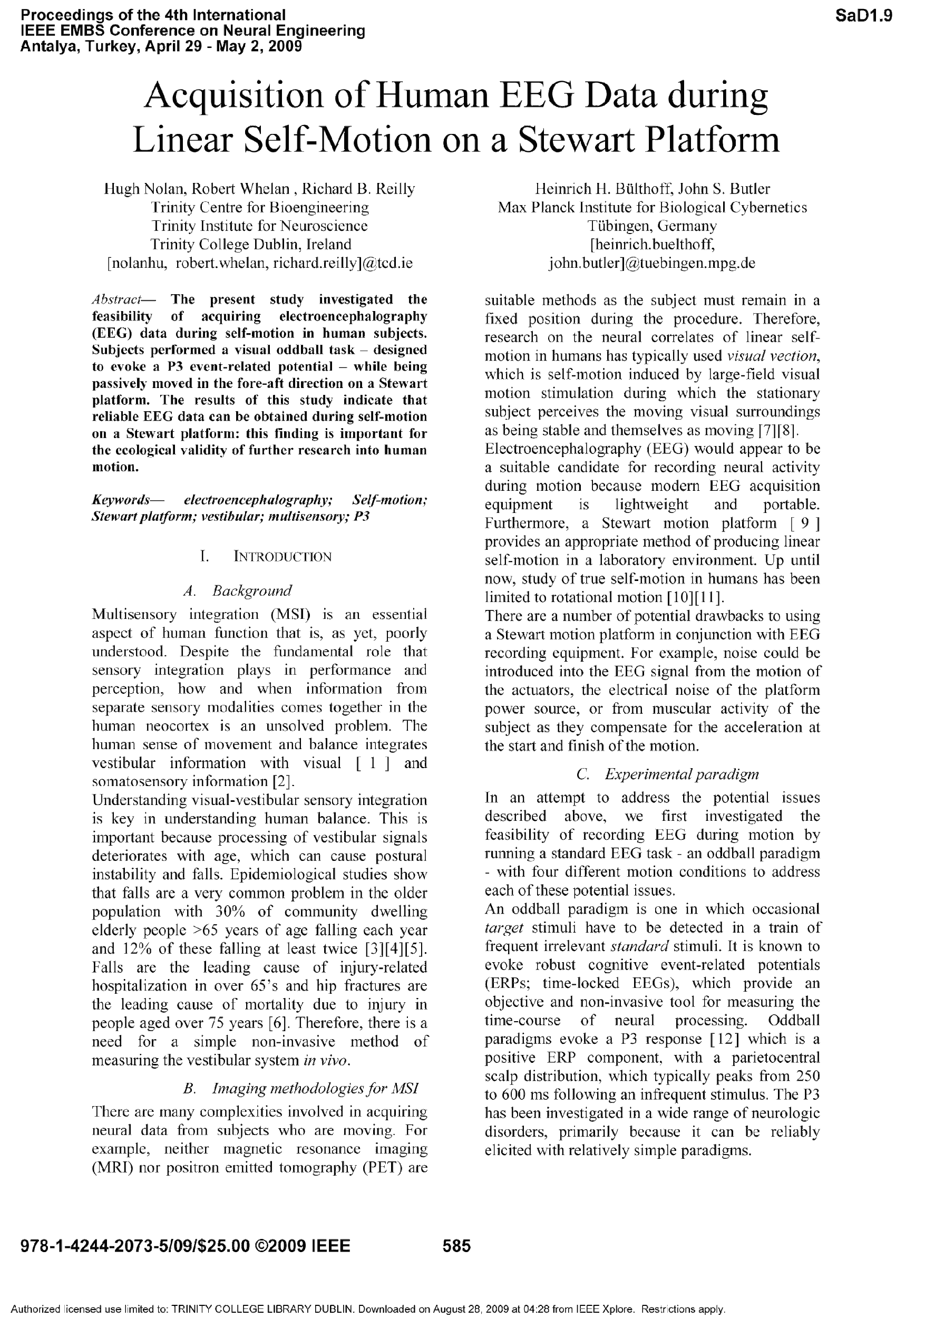
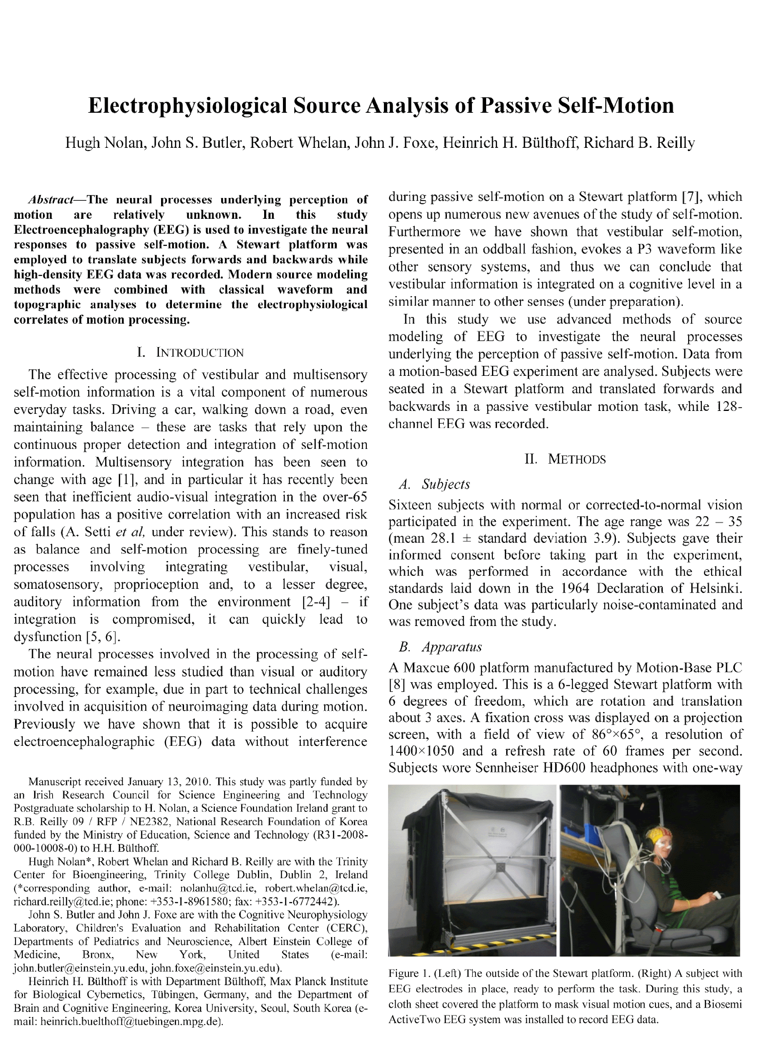
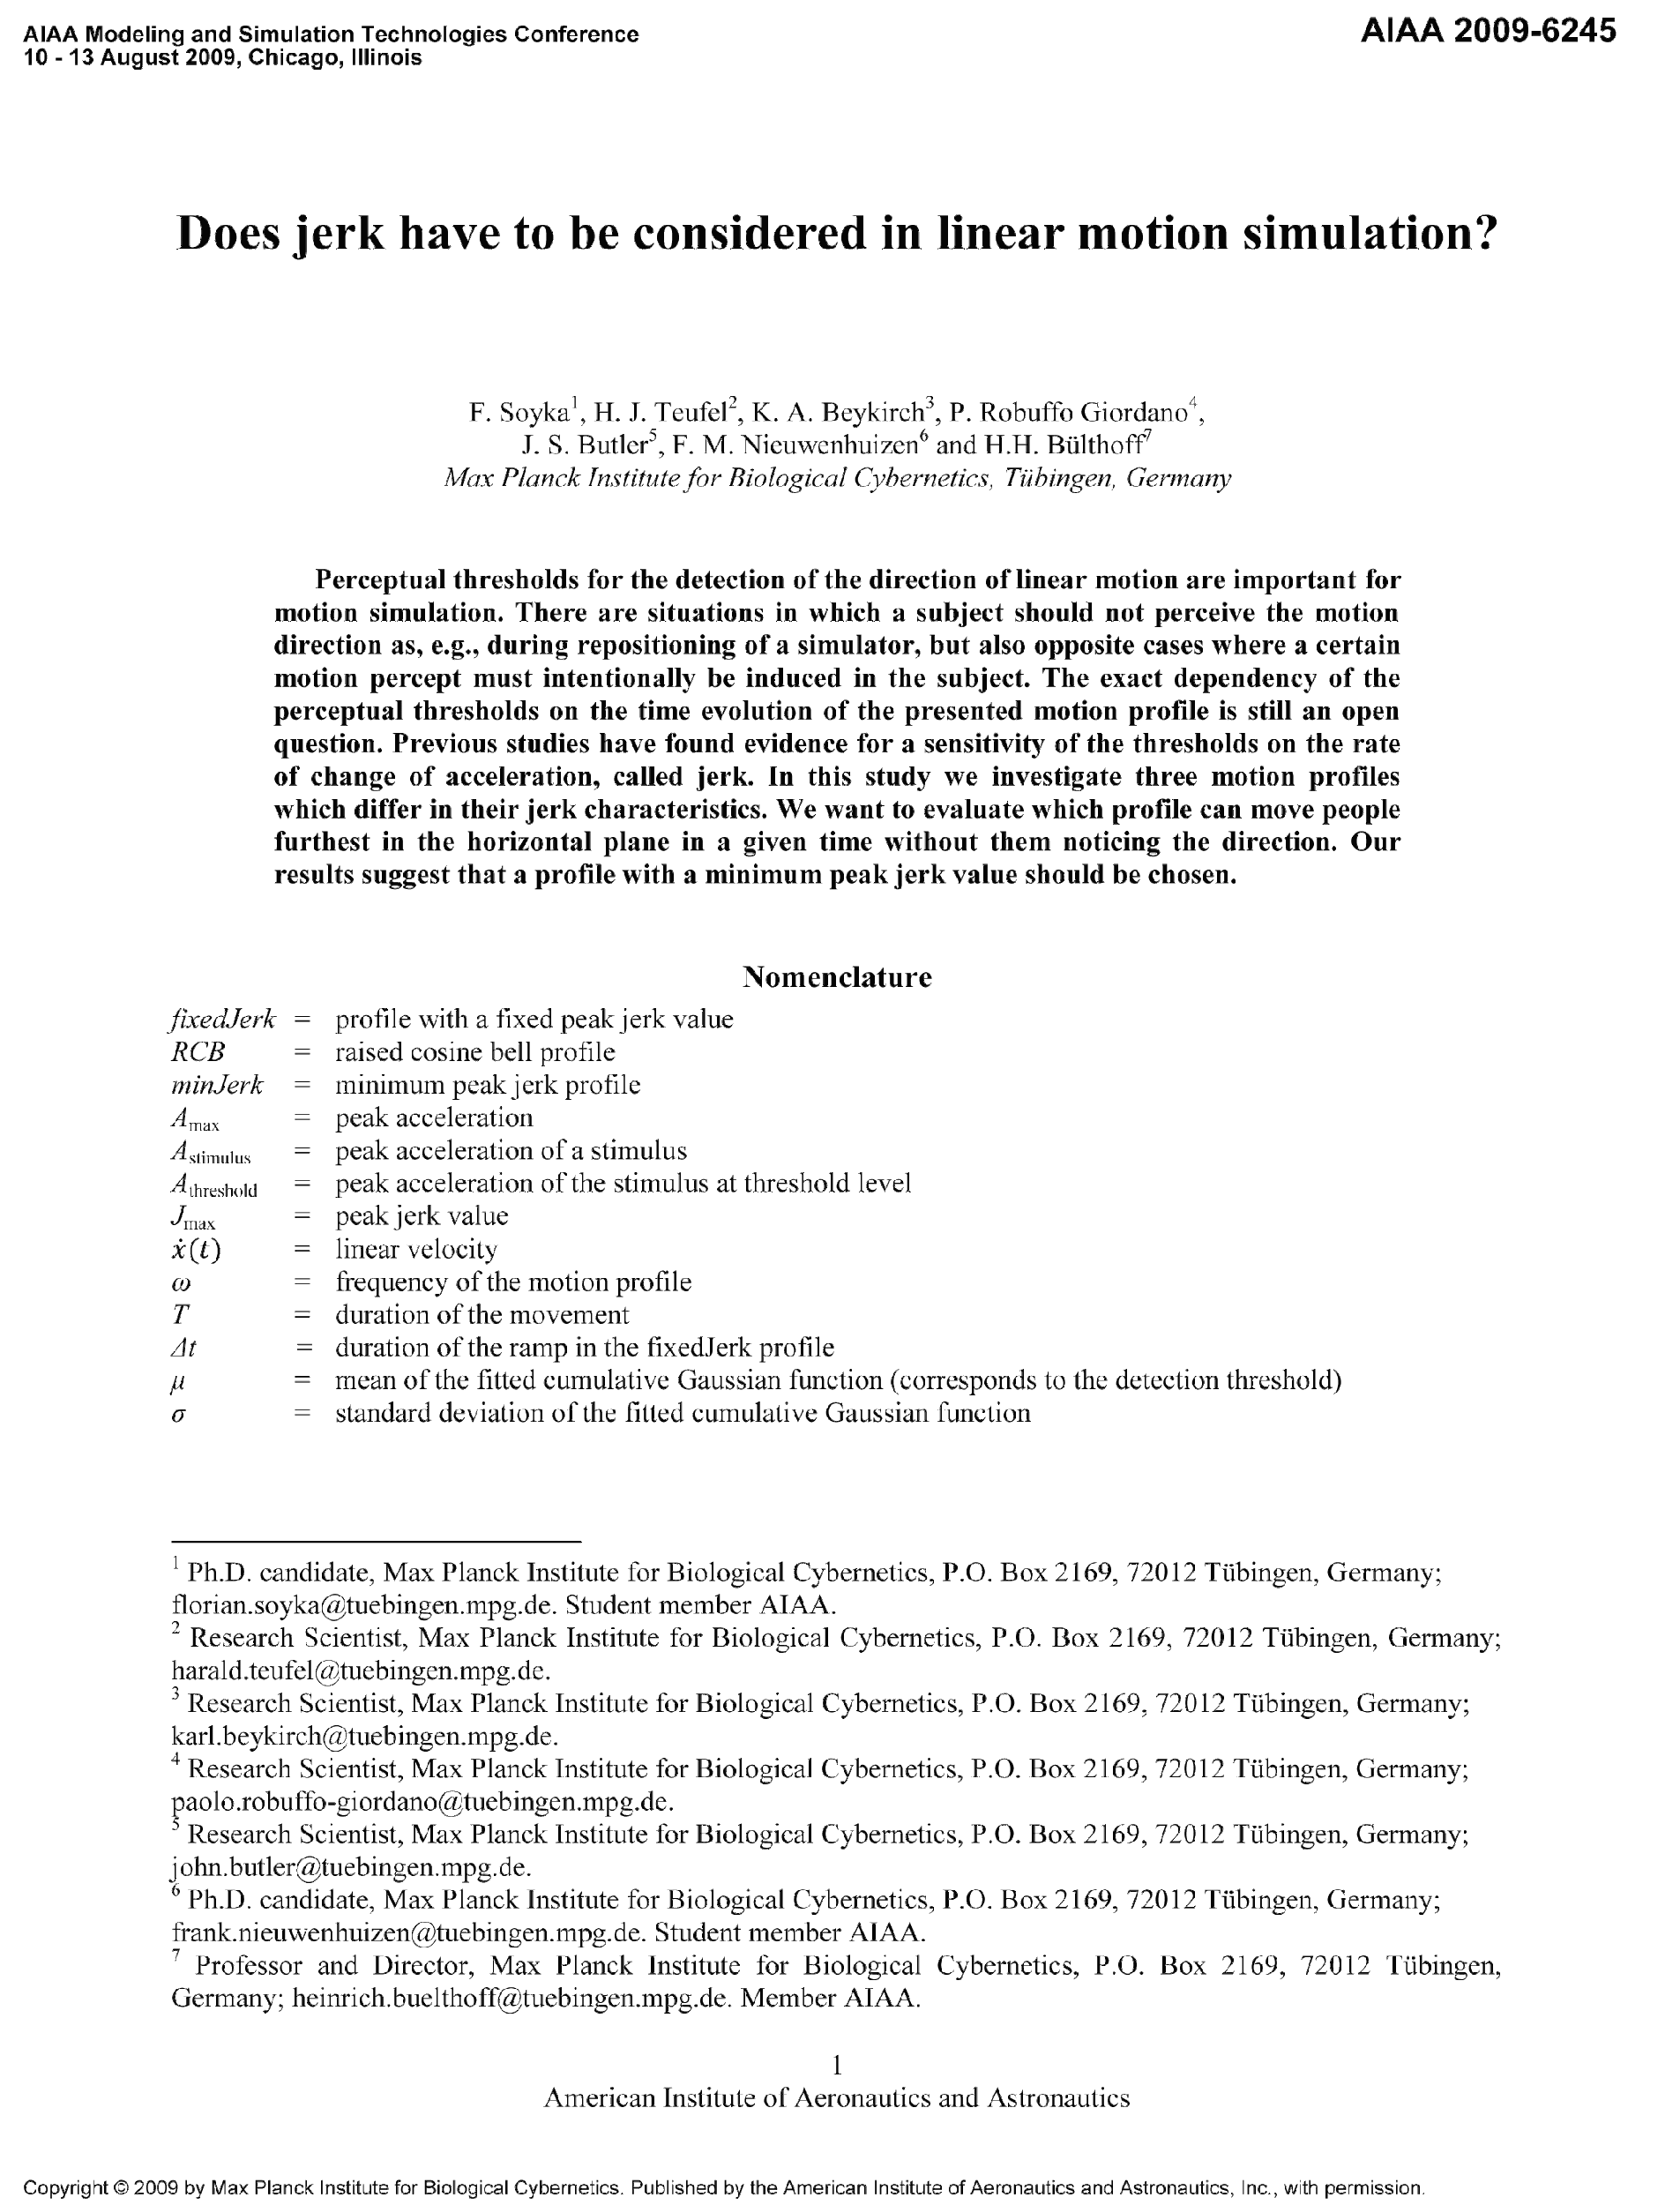
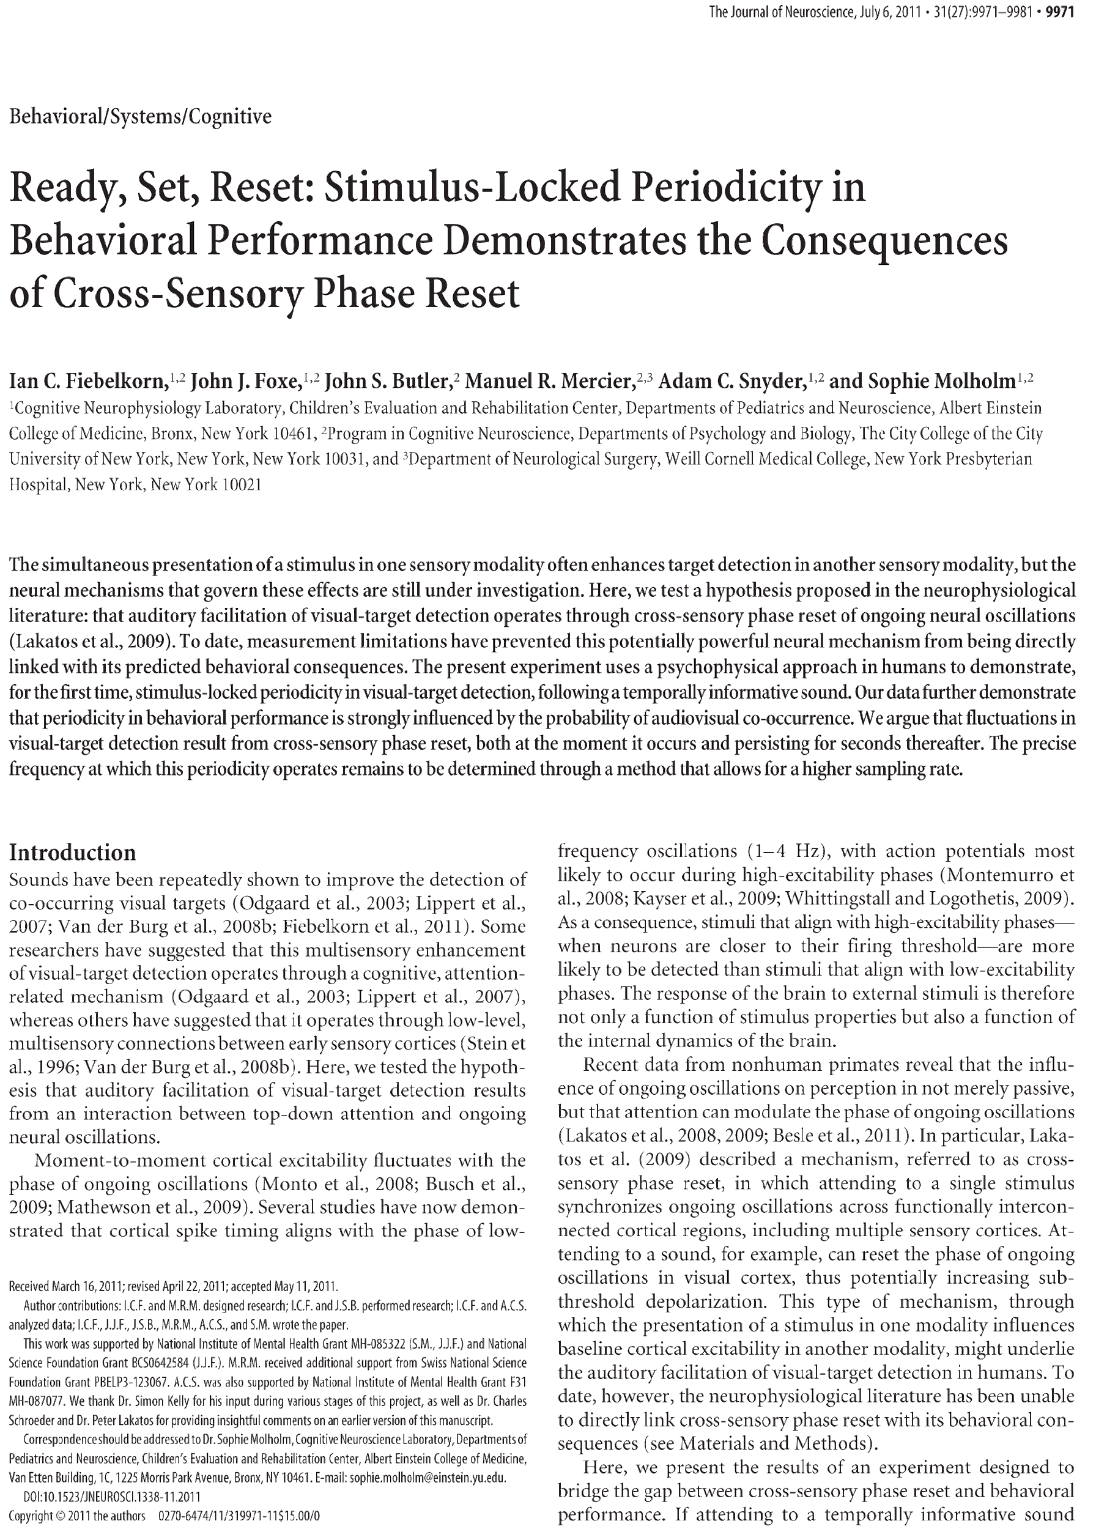
What do I write
Papers
Notes:
I am not sure kids will understand what is ‘papers’

Slide 9
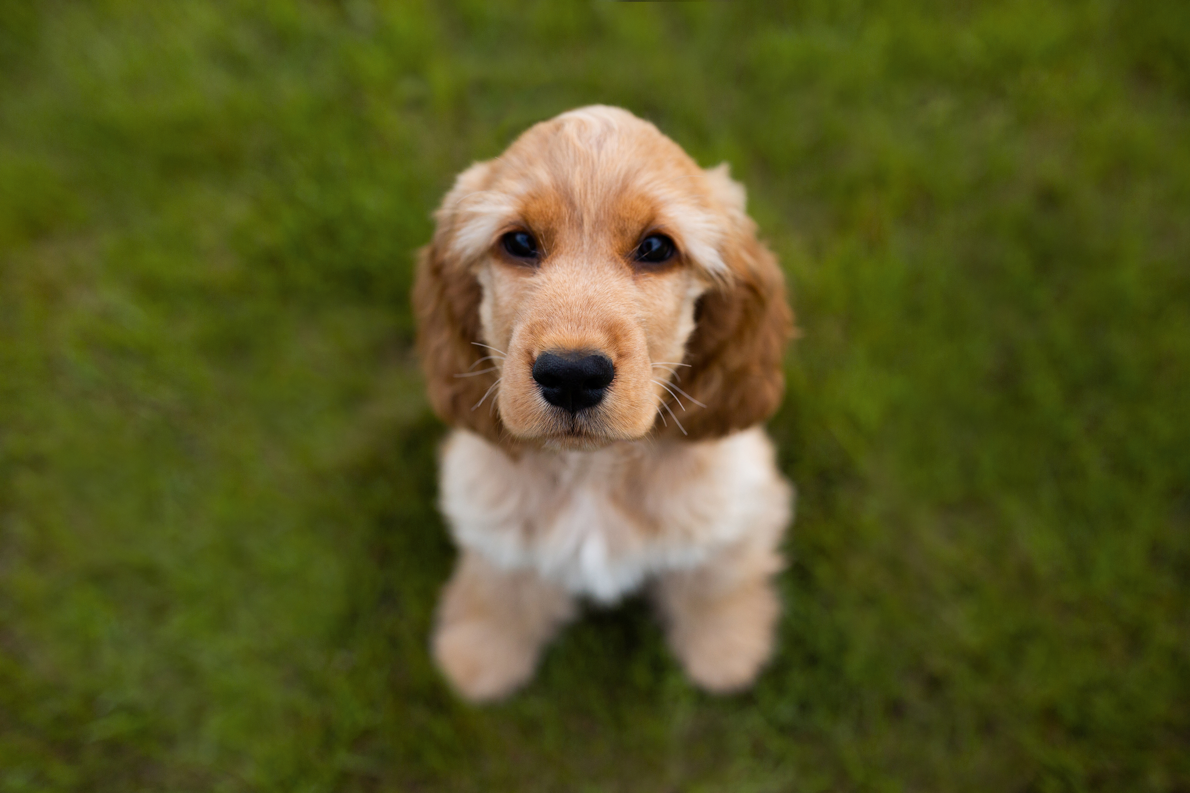
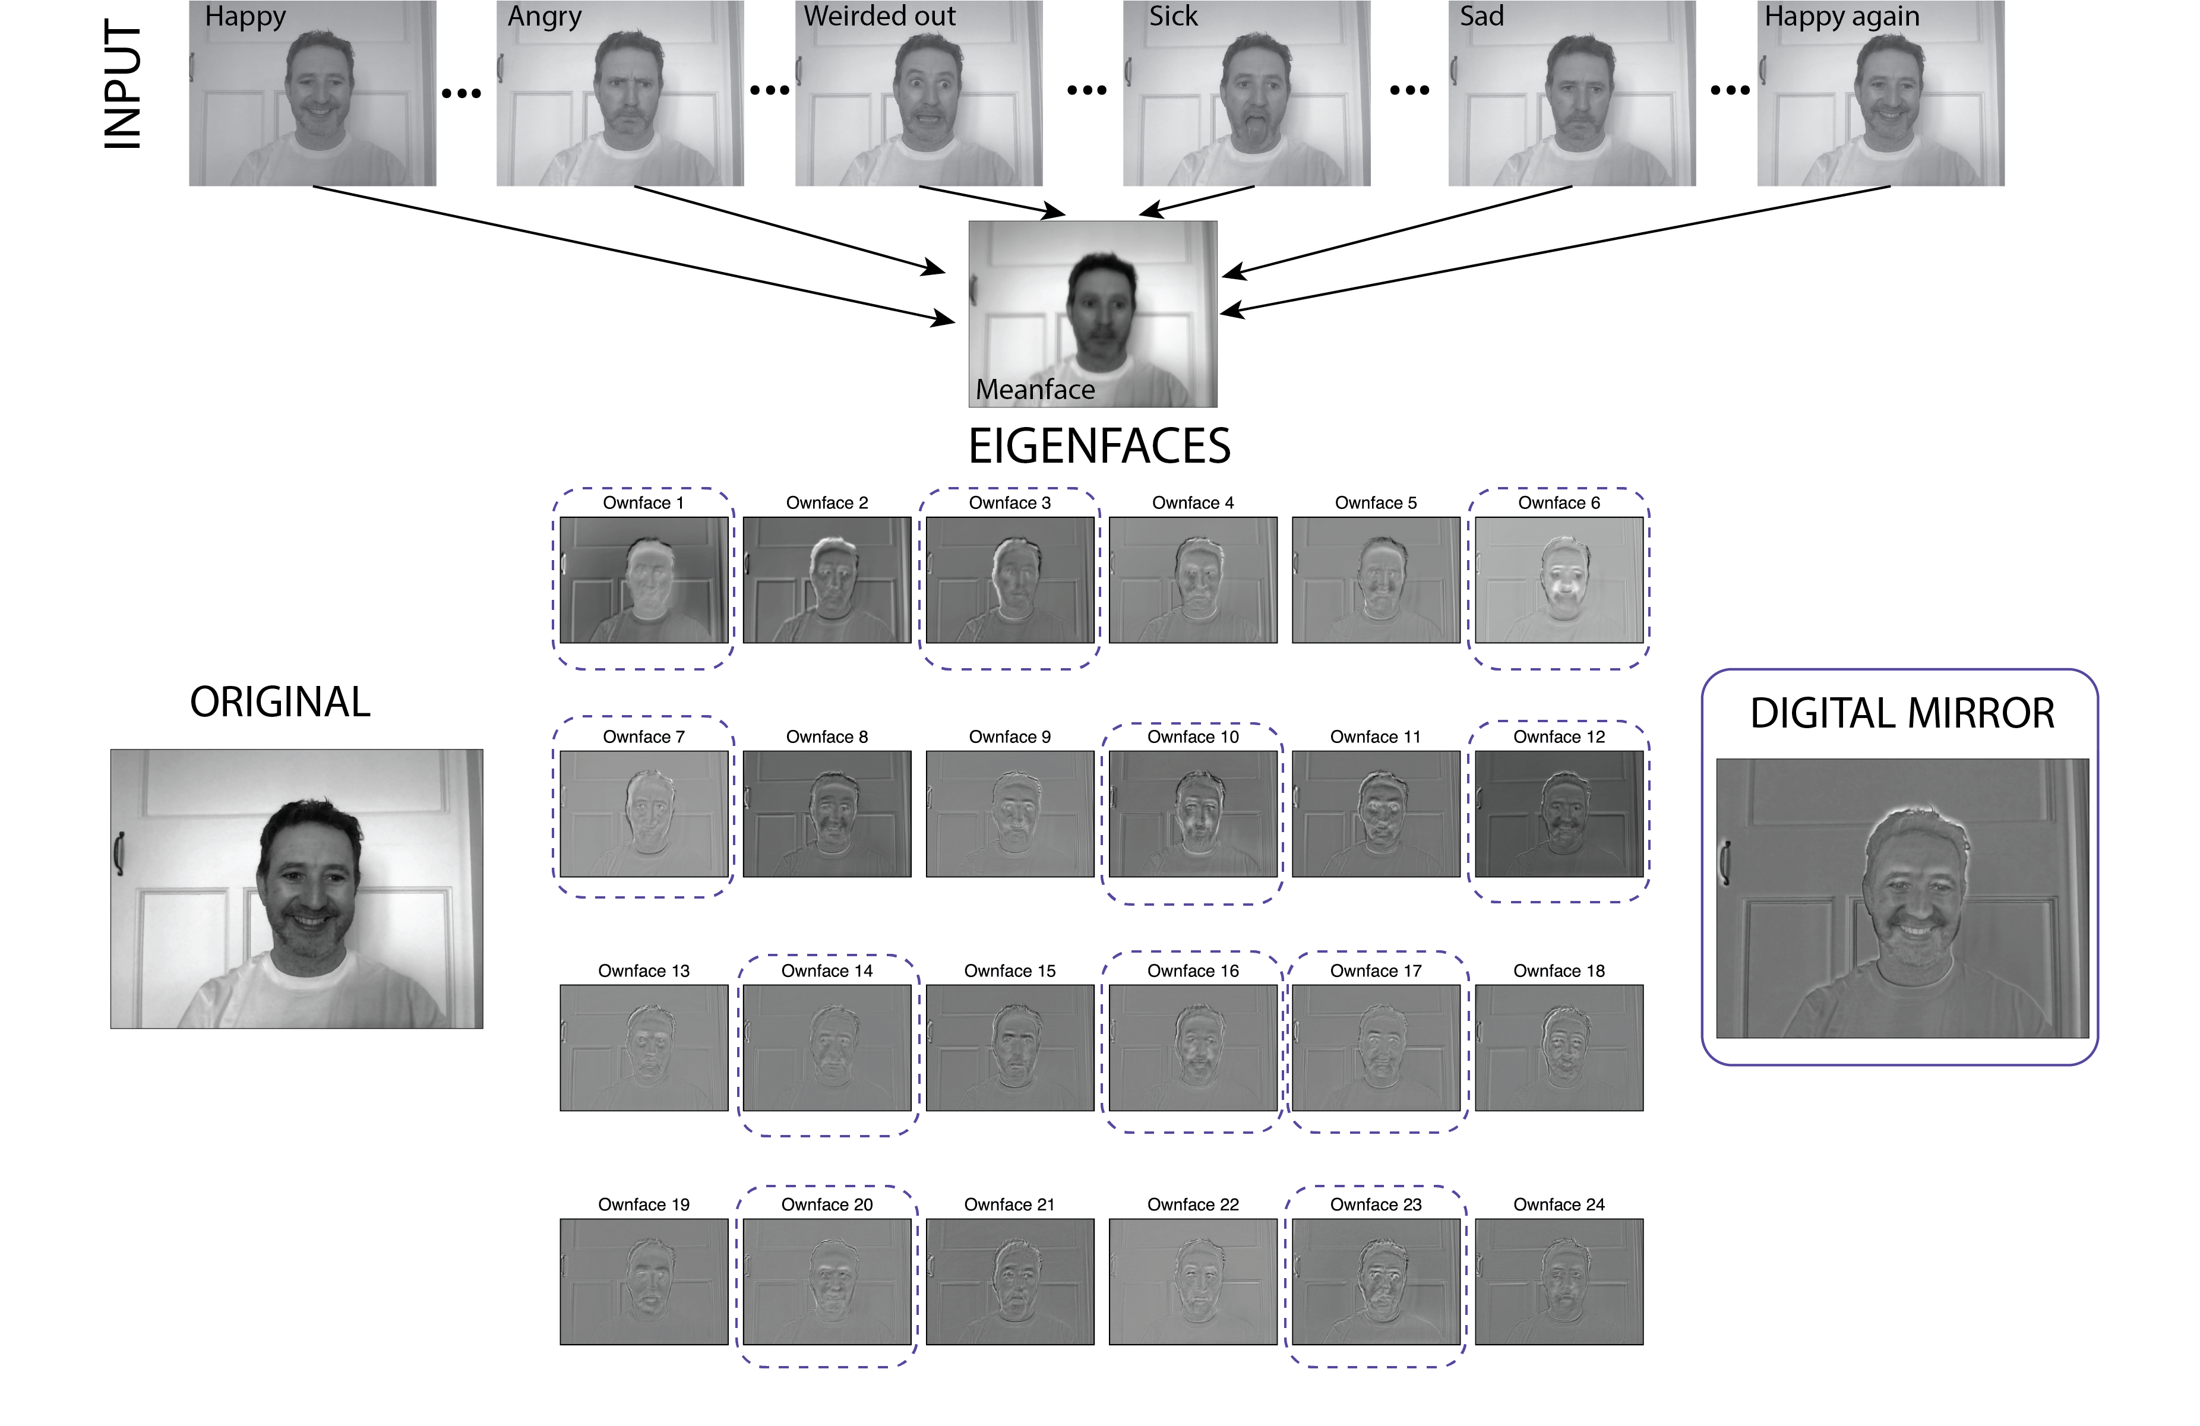
Choose Your Own Workshop
Predator Prey
Machine Learning and Neuroscience
Neuroscience and Walking
Neuroscience and Decision Making
Face Recognition

